Slide 1









RILS American Division
Welcome To !
Parents Orientation Day
2025-2026

Slide 2









Slide 3



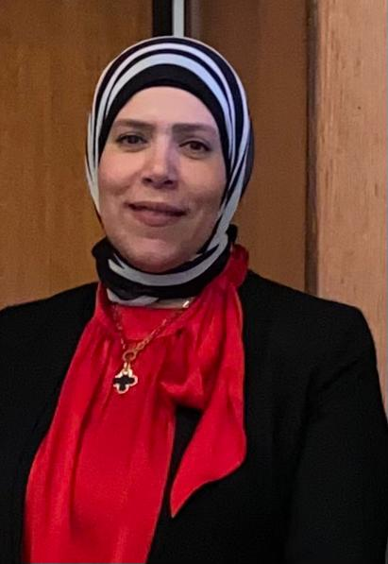

Dr . Lojayne Bedewy
General Director

Slide 4
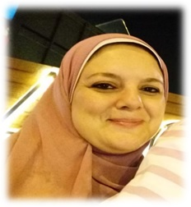
Mrs . Rabab Yehia
Principal Of The American Division

Slide 5
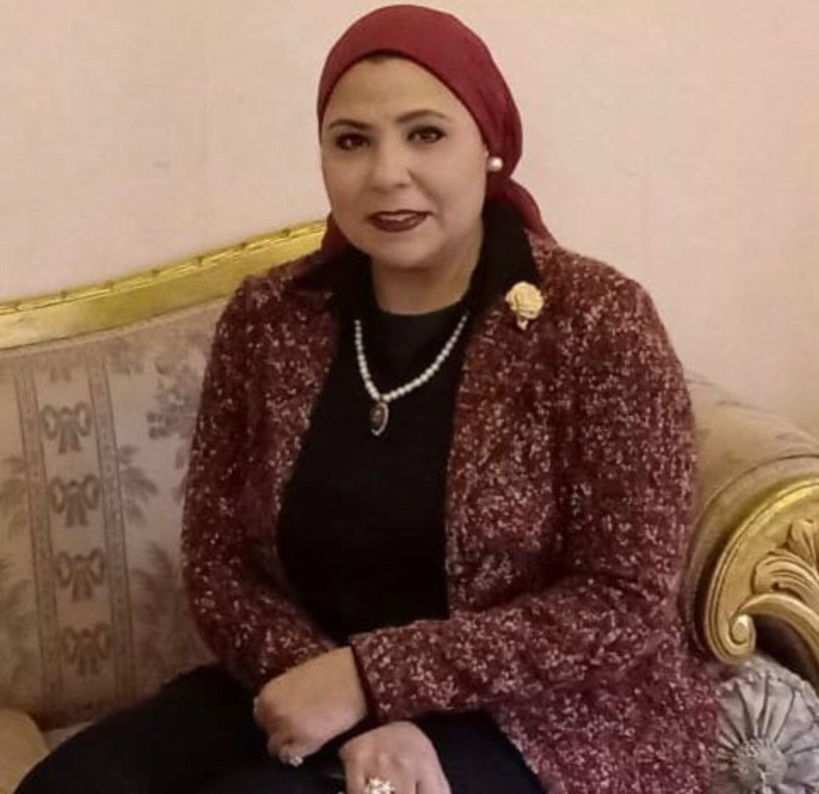
Mrs . Soha Tantawy
Vice Principal Of The American Division
Notes:
Vice

Slide 6







Dr . Hossam Ezz El Din
ACT Middle East, North of Africa,
and Egypt Director
& AMERICAN ACADEMY CEO

Slide 7







Slide 8


Mrs . Nahed Hassan English HOD

Slide 9


Name/ Occupation : MRS. Nahed Hassan – English HOD
Experience : 27 years
We're delighted to welcome you to our school's orientation day. We're committed to providing a supportive and nurturing environment for your children's growth and success. As educators, we have the passion for fostering a love of language and literature in high school students.
Course Book
myPerspectives is a powerful, next generation print and online language arts curriculum that places students at the center of learning, and gives teachers the right tools and resources, research-based guidance, and autonomy to support each unique learner in reading and writing.

Slide 10




Similarities/ Differences
  Both scholastic tests
  Both should be answered in a limited time

Slide 11


Slide 12
The SAT, or Scholastic Assessment Test
Purpose:
It is a standardized test widely used for college admissions all over the world. It assesses a student's readiness for college-level in reading, writing, and math.
*Egyptian Scholastic Test (EST):
Purpose:
The EST is specifically designed for students in Egypt who are applying to Egyptian universities (public, private, and national).
• Structure:
The EST has two main sections: EST 1 (mandatory for all) and EST 2 (required for science and engineering colleges).

Slide 13
-Content:
The test covers reading, writing and math.
-Format:
The SAT is a fully digital, computer-based test. It is adaptive, meaning that the difficulty of the second module in each section is adjusted based on the student's performance in the first module.
Reading and Writing
54 questions, divided into two modules (27 questions per module). Each module: 32 min.
EST I:
Paper-based test
Literacy Test 1 (reading, writing, and math )
Writing Test: 44 multiple-choice questions in 35 minutes.
Literacy Test 2 (Reading): 52 multiple-choice questions in 65 minutes.

Slide 14





Academic
Vision & Mission

Slide 15





Vision
To empower every student to reach their highest potential,
foster a love for lifelong
learning, and develop the skills, resilience,
and empathy needed to thrive as global citizens.

Slide 16


Mission
Our mission is to provide a safe, inclusive,
and challenging environment that
promotes academic excellence, personal growth,
and responsible citizenship.
We are committed to engaging students in critical thinking,
innovation, and collaboration while respecting diverse perspectives. Through a supportive
and engaging community, we prepare our students to excel in higher
education and their future careers,
becoming leaders who positively impact the world.

Slide 17



What about the curriculum in our American Division for grades 10&11&12?

Slide 18
GRADE 10
Subject | Credits
English | 1 credit
Math | 1 credit
Biology | 1 credit
World History | 1 credit
Arabic | 1 credit
Second Language | 1 credit
Art | ½ credit
Physical Education | ½ credit
Computer | 1 credit
Total Credits | 8 credits

Slide 19
GRADE 11
Subject | Credits
English | 1 credit
Math | 1 credit
Chemistry | 1 credit
Sociology | 1 credit
computer | 1 credit
Second Language | 1 credit
Art | ½ credit
Physical Education | ½ credit
Total Credits | 7 credits

Slide 20
GRADE 12
Subject | Credits
English | 1 credit
Advanced Math | 1 credit
Physics | 1 credit
Business | 1 credit
Advanced Biology | 1 credit (Optional)
Advanced Mechanics | 1 credit (Optional)
Art | ½ credit
Computer | 1 credit
Physical Education | ½ credit
Total Credits | 6 credit

Slide 21
School Assessment
100%
40%
GPA
60%
EST/SAT/ACT

Slide 22
School Assessment
Quizzes | Behavior | Attendance | Assignment | Participation | Project | Exam | Total
10 | 10 | 10 | 10 | 10 | 20 | 30 | 100

Slide 23


EST/ACT/SAT sessions
ACT center
Map tests

Slide 24


Slide 25
What is MAP Growth
And
what does it measure?

Slide 26
1-MAP Growth is a computerized and standardized test.
2-Every student gets a unique set of test questions based on responses to previous questions.
3-As the student answers correctly, questions get harder.
4-If the student answers incorrectly, the questions get easier.

Slide 27
5- Scores appear automatically
after finishing the exam.

Slide 28
What is the purpose of MAP Growth test?
The purpose of MAP Growth is to determine what students know and how they are growing academically.

Slide 29
How often will students take MAP Growth?
1-MAP Growth test will be given to students twice per year.

Slide 30
How long does MAP Growth take?
Most students take around 45 to 55 minutes to complete a MAP Growth test. However, MAP Growth is not timed, and students may take as much time as they need to complete it.

Slide 31
What subjects are available with MAP Growth?
MAP Growth in English covers the following: (English)
Reading: Grades K–12
Language Usage: Grades 2–12
Math: Grades K–12

Slide 32
What types of questions are on the MAP Growth tests? Are there sample tests?
1-The MAP Growth tests is multiple choice one.
2-You can access some short sample tests to get an idea of what MAP Growth questions look like.

Slide 33

Is there a pass and a failure in the Map Growth test?

Slide 34


Slide 35


English Department

Slide 36

Mr . Eslam Abdelaziz
English Teacher

Slide 37

Mr . Mohamed Serag
English Teacher

Slide 38


Ms . Mariam Yousry
English Teacher

Slide 39



Mathematics Department

Slide 40



Mr . Hussein Sabry
Math HOD
+
Mechanics teacher

Slide 41


Mr . Mohamed Abdel Aziz
Advanced Math Teacher

Slide 42
Mrs . Marian Magdy
Math Teacher

Slide 43




Science Department

Slide 44



Dr . Ayat Magdy
Science Teacher

Slide 45


Mr . Fouad Hadad
physics Teacher

Slide 46


Mrs . Mariam Moeen
chemistry Teacher +
Advanced Biology

Slide 47


French Department

Slide 48



Mrs . Neveen Farrag
French Teacher

Slide 49


German
Department

Slide 50

Mrs . Toka Hazim
German Teacher

Slide 51


Social Studies Department

Slide 52


Mr . Ahmed Fouaad
Social Teacher

Slide 53



Arabic Department

Slide 54


Mr . Bahaa Hussin
Arabic Teacher

Slide 55


ICT
Department

Slide 56



Mr . Ali Mohammed
Computer Teacher

Slide 57



Art
Department

Slide 58


Mrs . Walaa Swedan
Art Teacher

Slide 59
PE
Department

Slide 60
Captain. Mostafa Moafy
PE HOD

Slide 61
Social worker
Department

Slide 62
Mrs . Shaimaa khater
Social worker

Slide 63
IT
Department

Slide 64
Mr . Yahia Hamdy
IT manager

Slide 65
Mrs . Eman Suliman
IT department

Slide 66
Activity
Department

Slide 67
Mrs . Hala Afifi
Activity coordinator

Slide 68


– Materials
–Videos - PPTs
– Online Quizzes and Exams
–Daily Assignments
– Projects

Slide 69

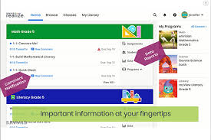

Slide 70
Savvas platform is important because it offers the following:
– an innovative, integrated Learning Management System
– digital resources, tools, and personalized learning pathways for students
– adaptive online assessments (exams)
– effective tools for differentiated instruction and student engagement

Slide 71




School Rules

Slide 72


School Time
School gates open at 7:30 am
and close at 7:45 am
school day ends at 2:20 pm.
-All the students must attend the morning assembly daily.

Slide 73


Dress code
Uniform must be clean and in good form.
Students must come in plain black or white shoes.
Veils must be plain white only. Black veils are not allowed.
Boys must keep their hair short, clean, and combed at all times.
Girls must have their hair combed, clean, and tied at all times.
Jeans, caps, accessories, and any out of uniform items are not allowed.
Sandals, slip on shoes, or football shoes with clogs, are not allowed in school.
Jewelry is not allowed except for rubber watches and small ear studs for girls.
Make-up, nail polish, and dyed hair are prohibited.

Slide 74

Mobiles
Mobiles will be collected from students at the early morning of the day.
Note :
Smart watches are not allawed

Slide 75
Senior walk
2024/2025

Slide 76

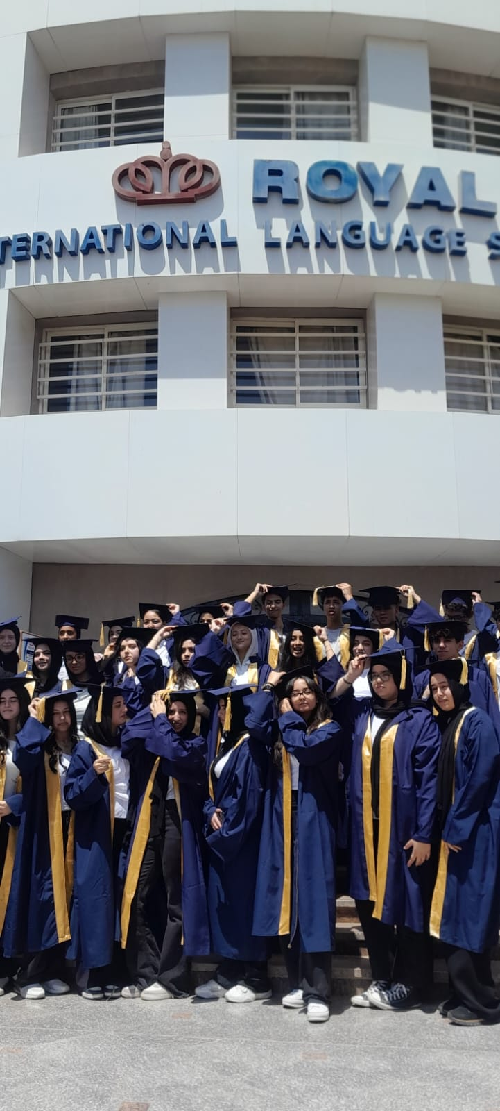

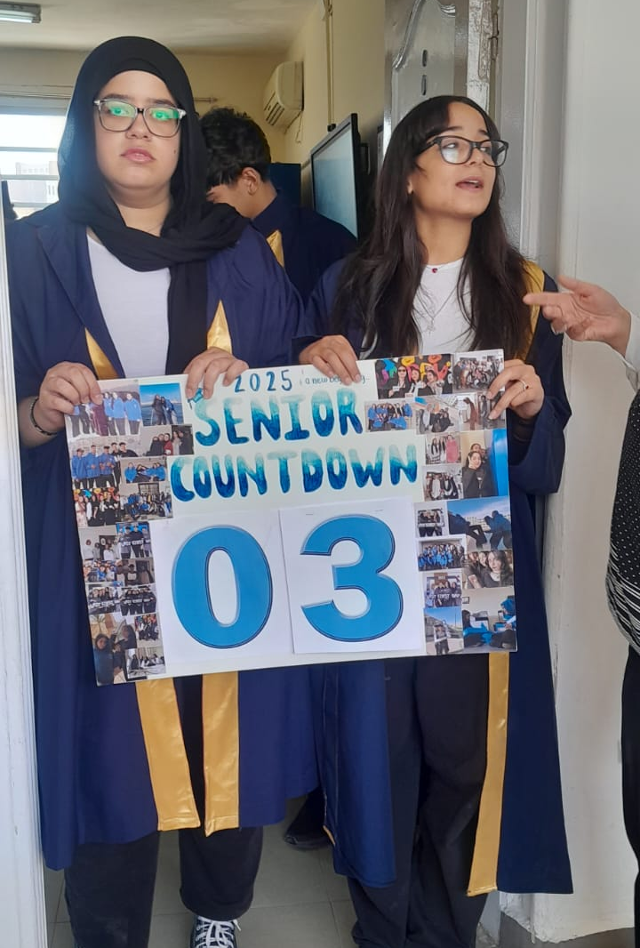
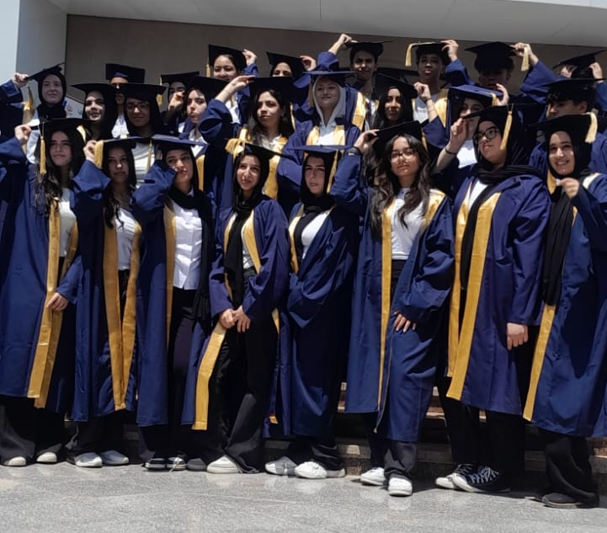

Slide 77
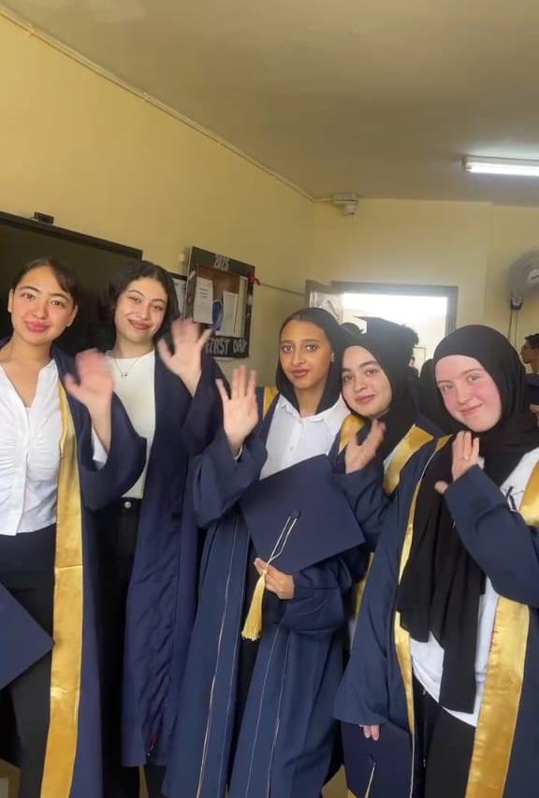
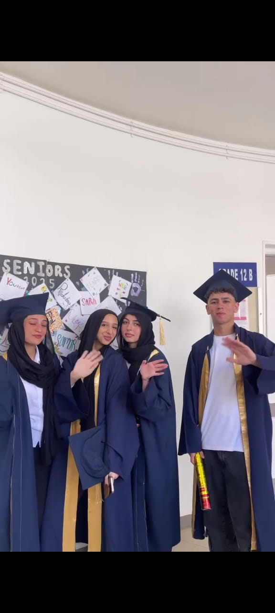
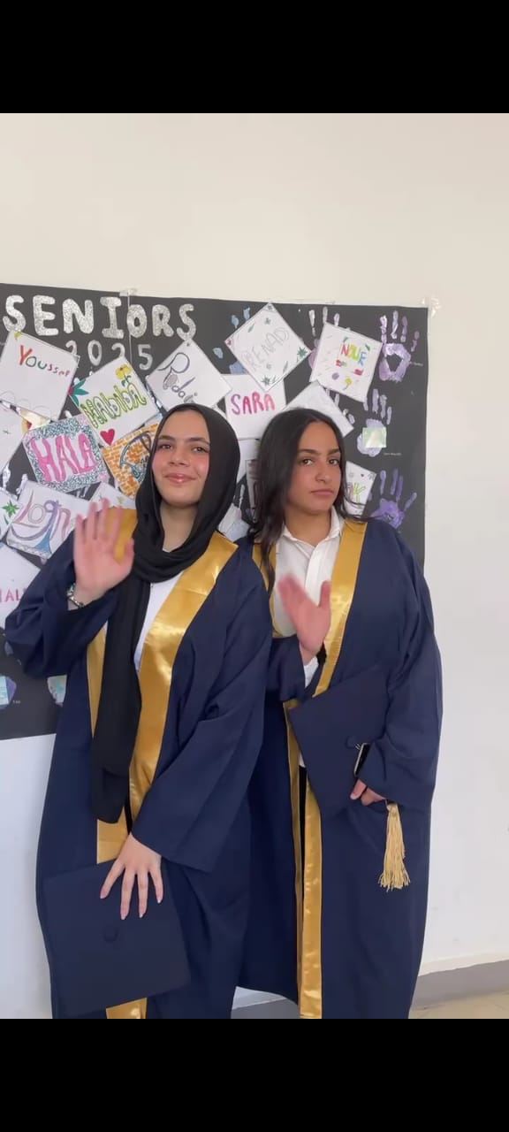
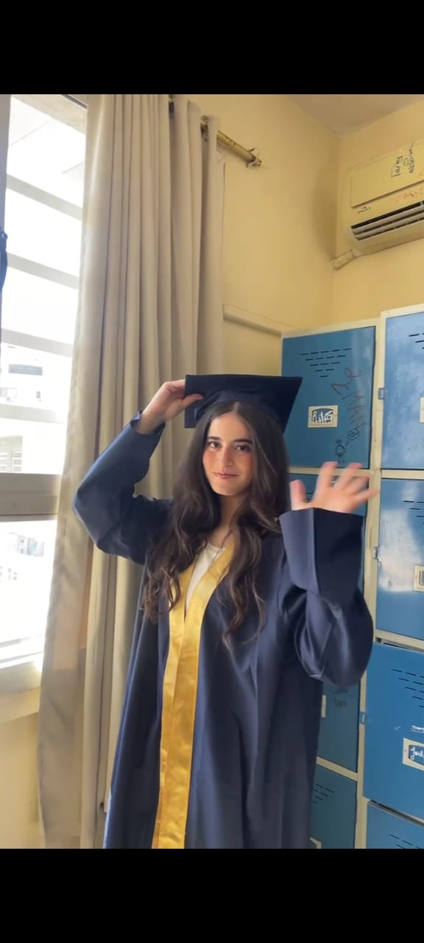

Slide 78
American Division
Academic Year 2024/2025
TOP ACHIEVERS

Slide 79



Slide 80



School facilities
And
Events

Slide 81
School facilities

Slide 82
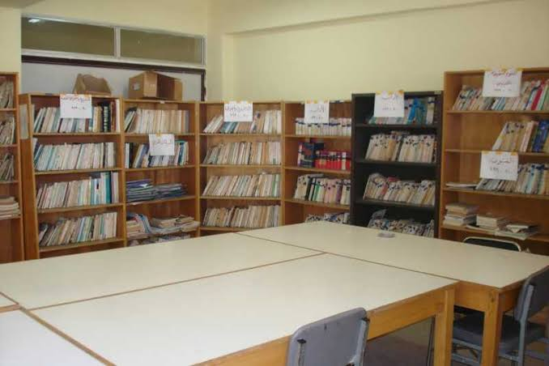
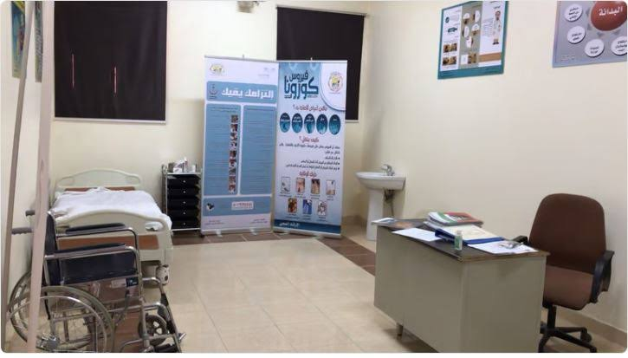
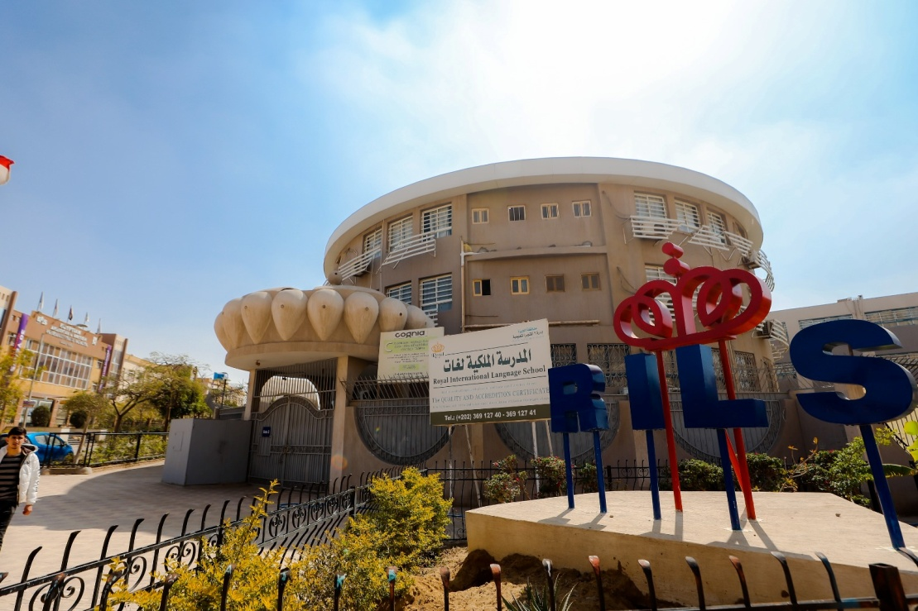
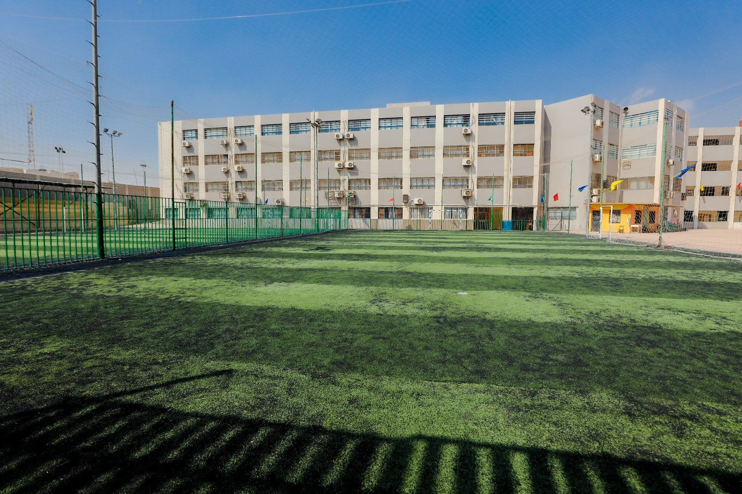
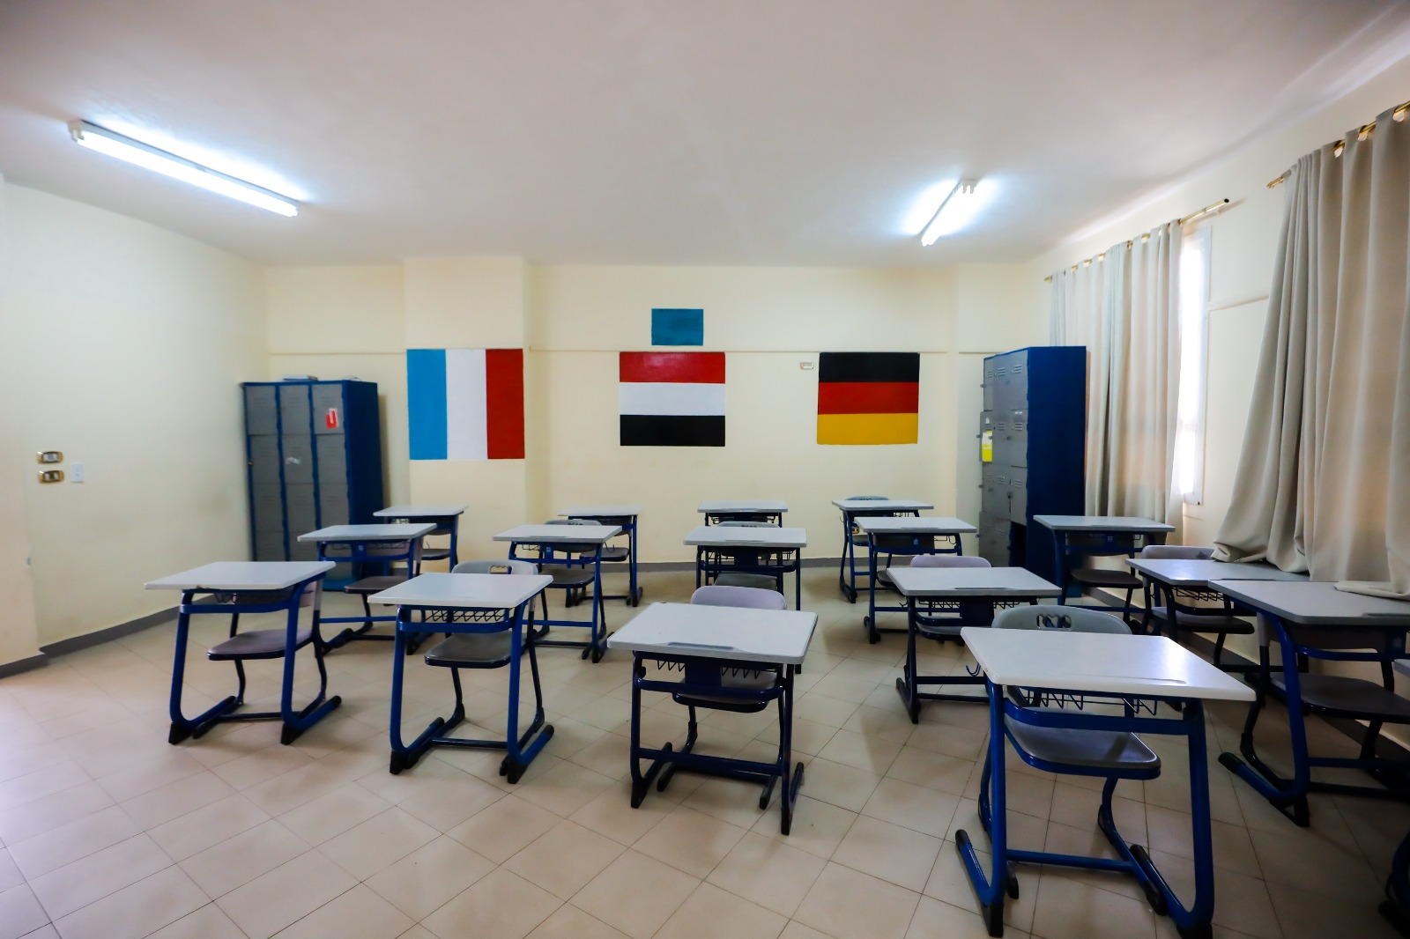

Slide 83
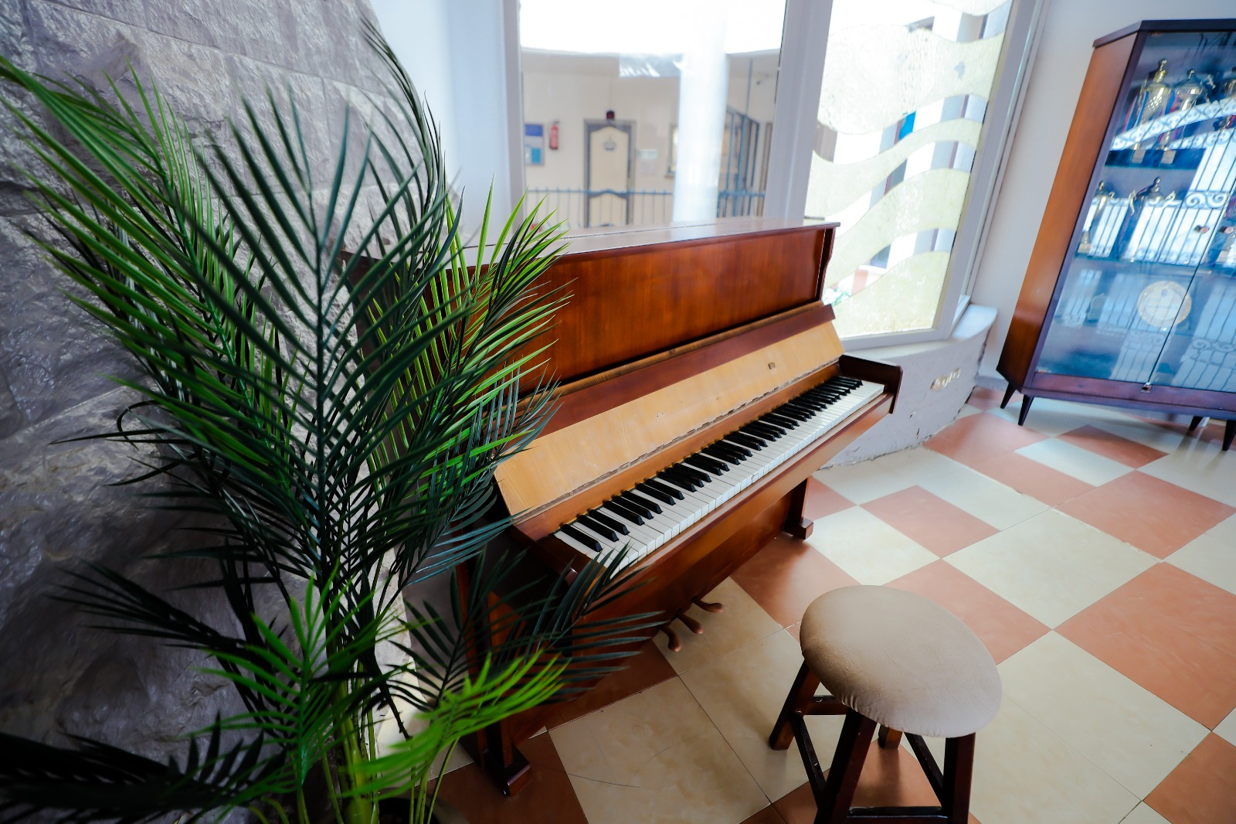
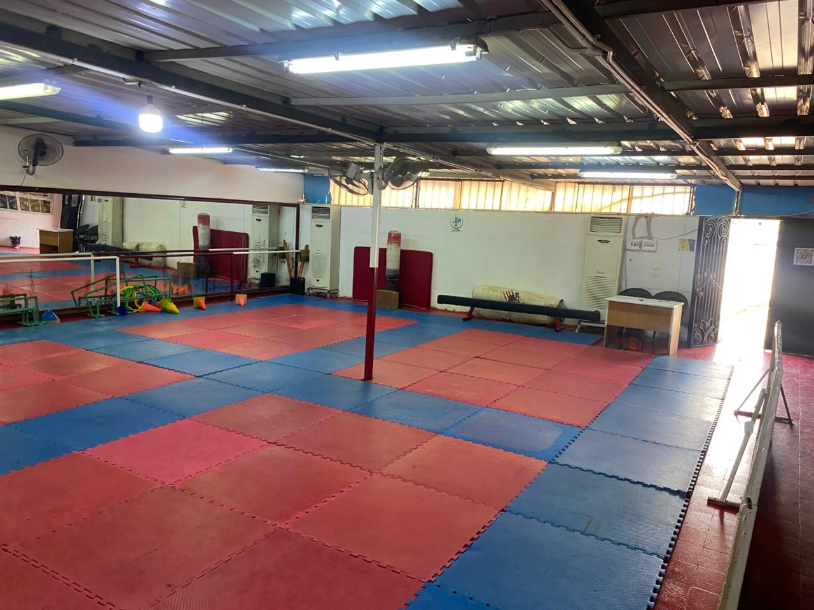
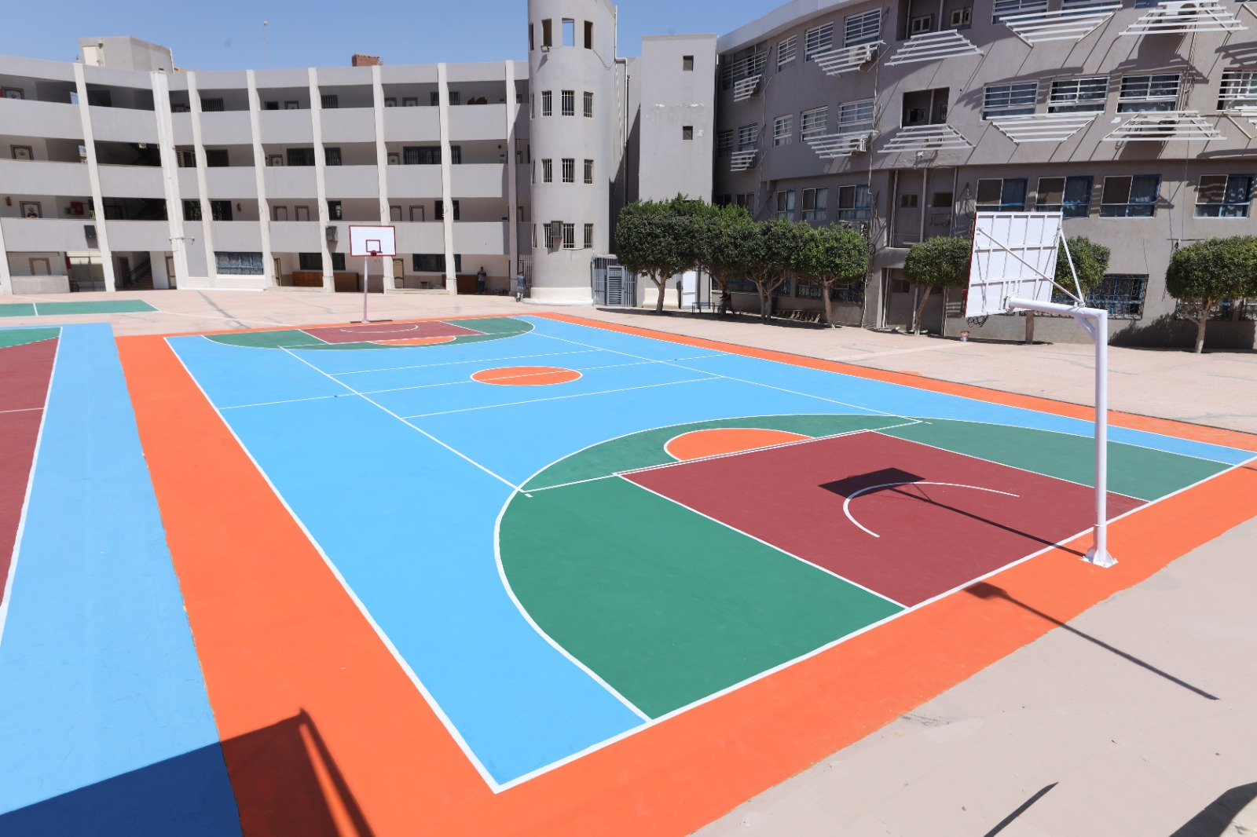
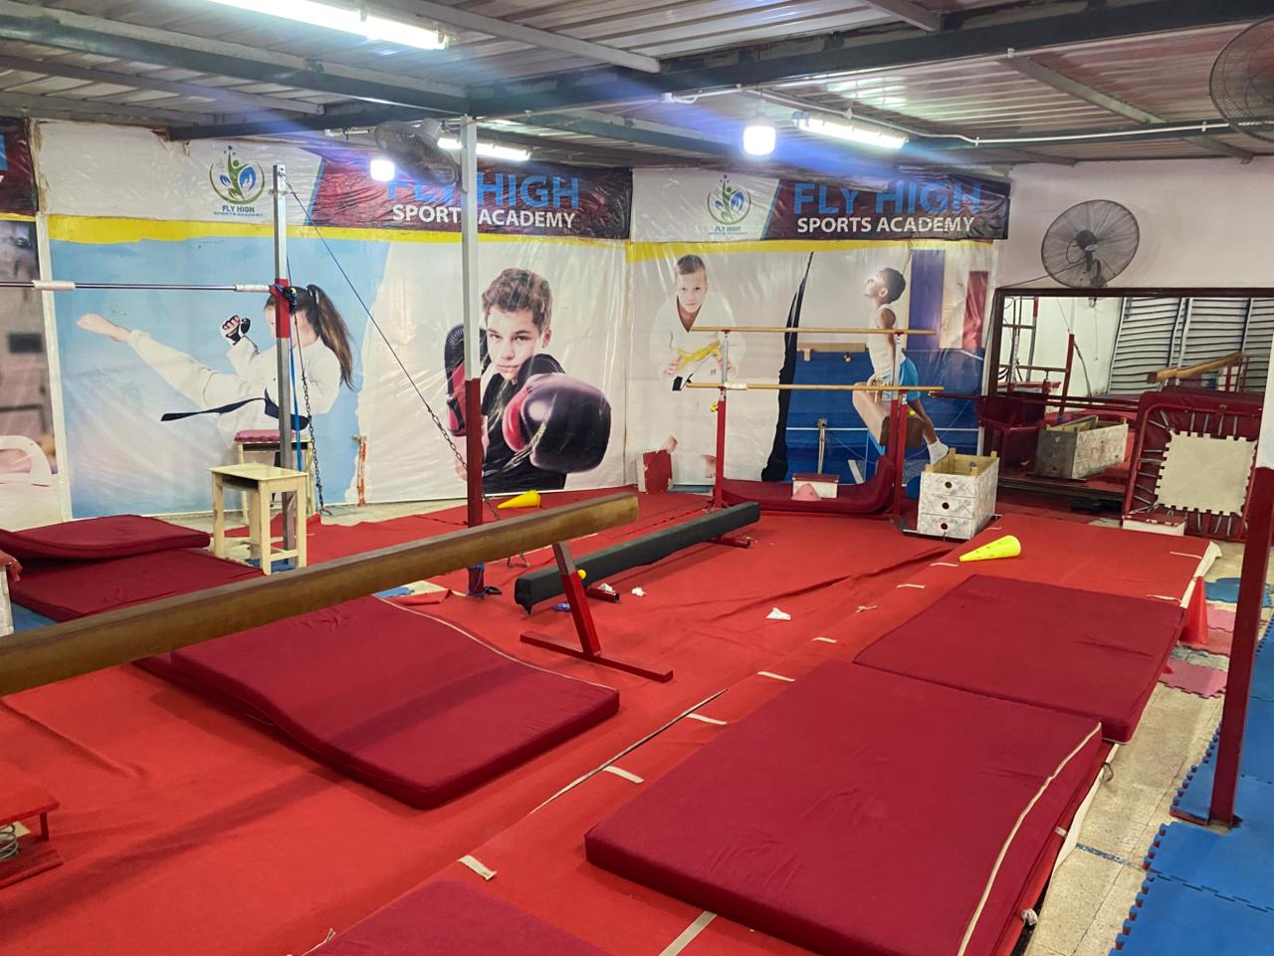
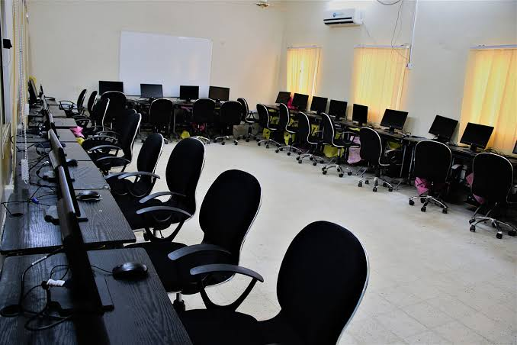

Slide 84
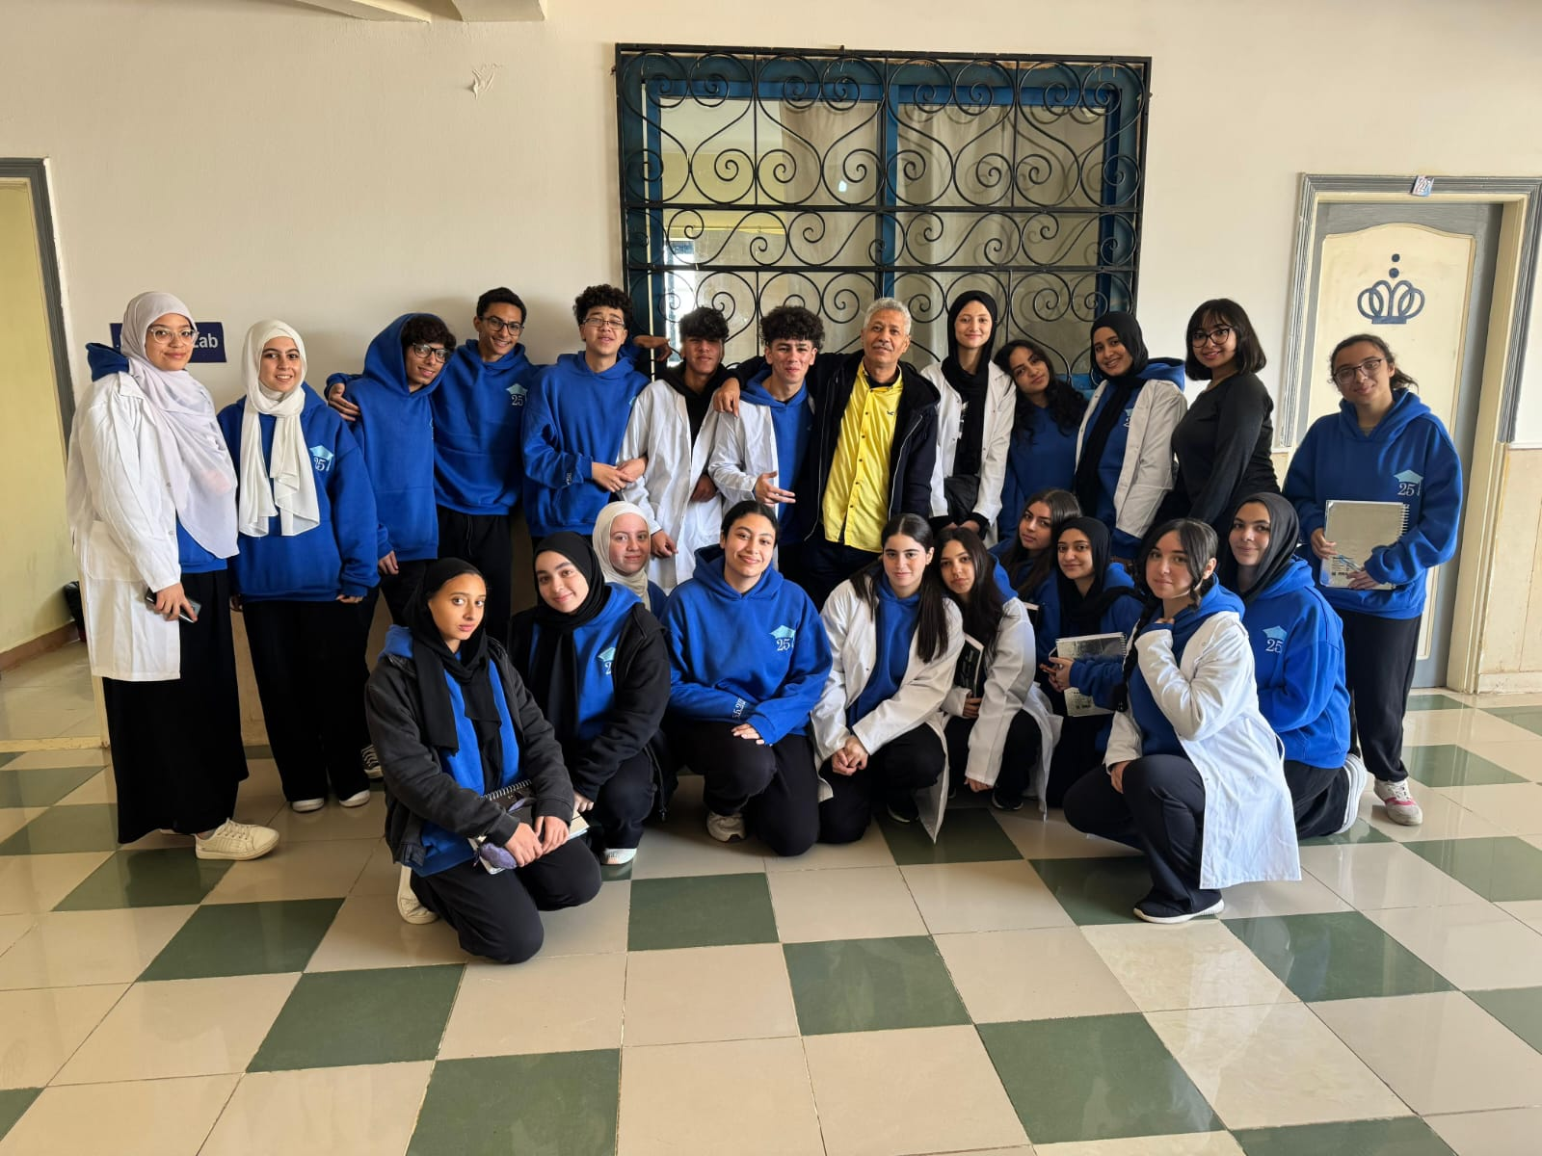
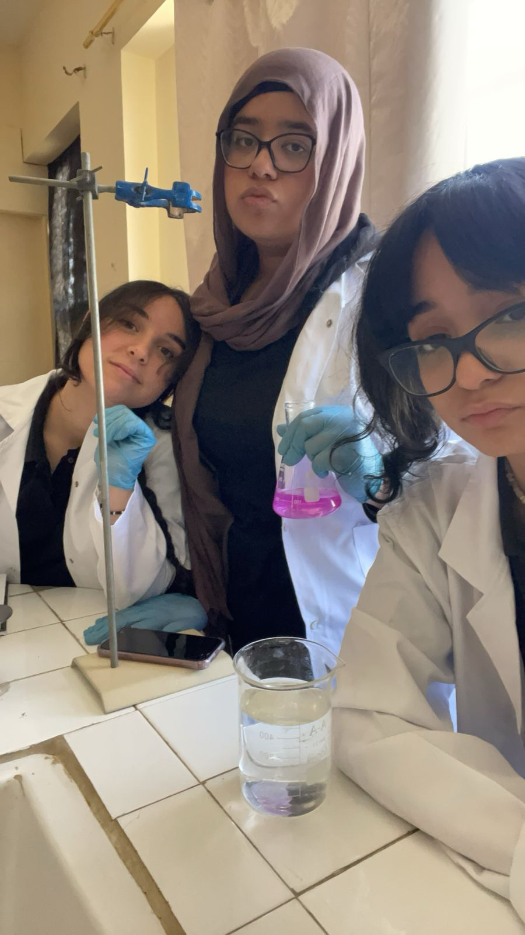
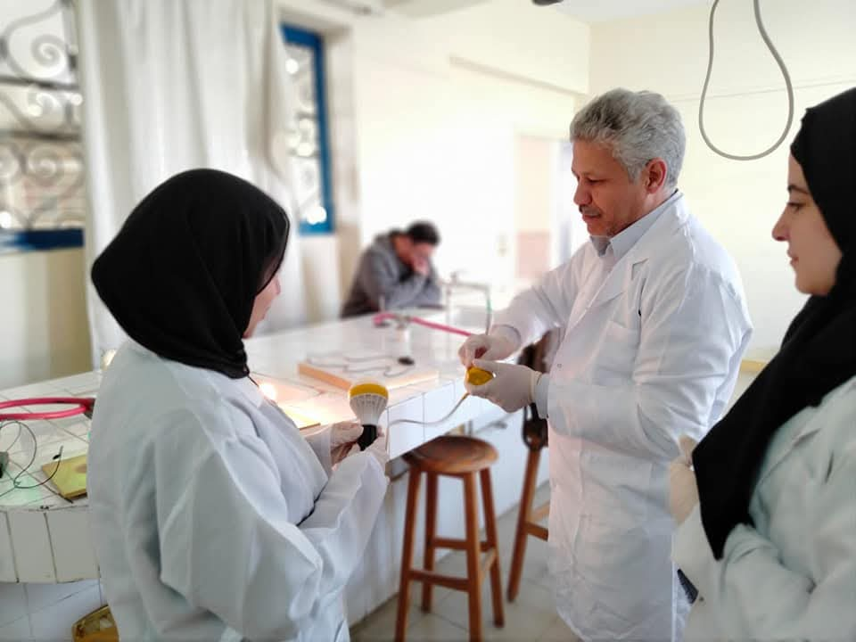

Slide 85
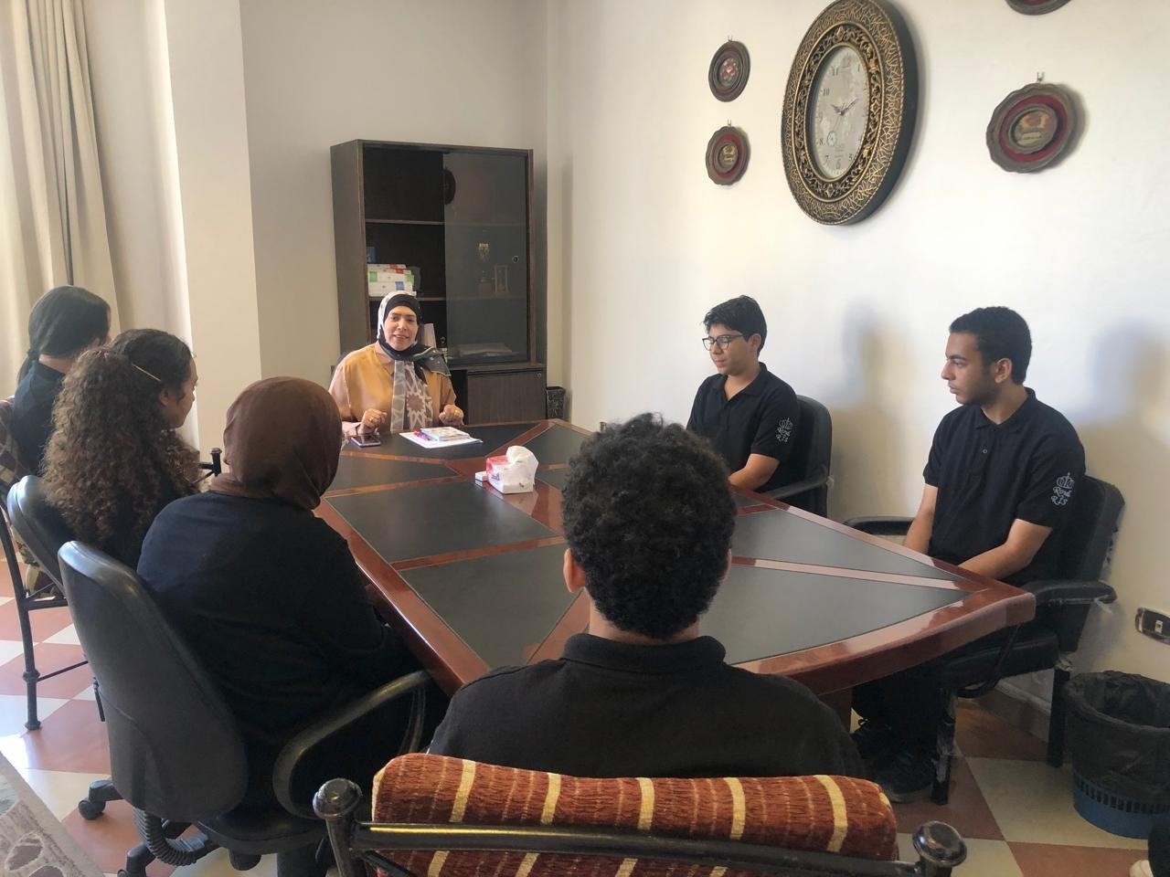
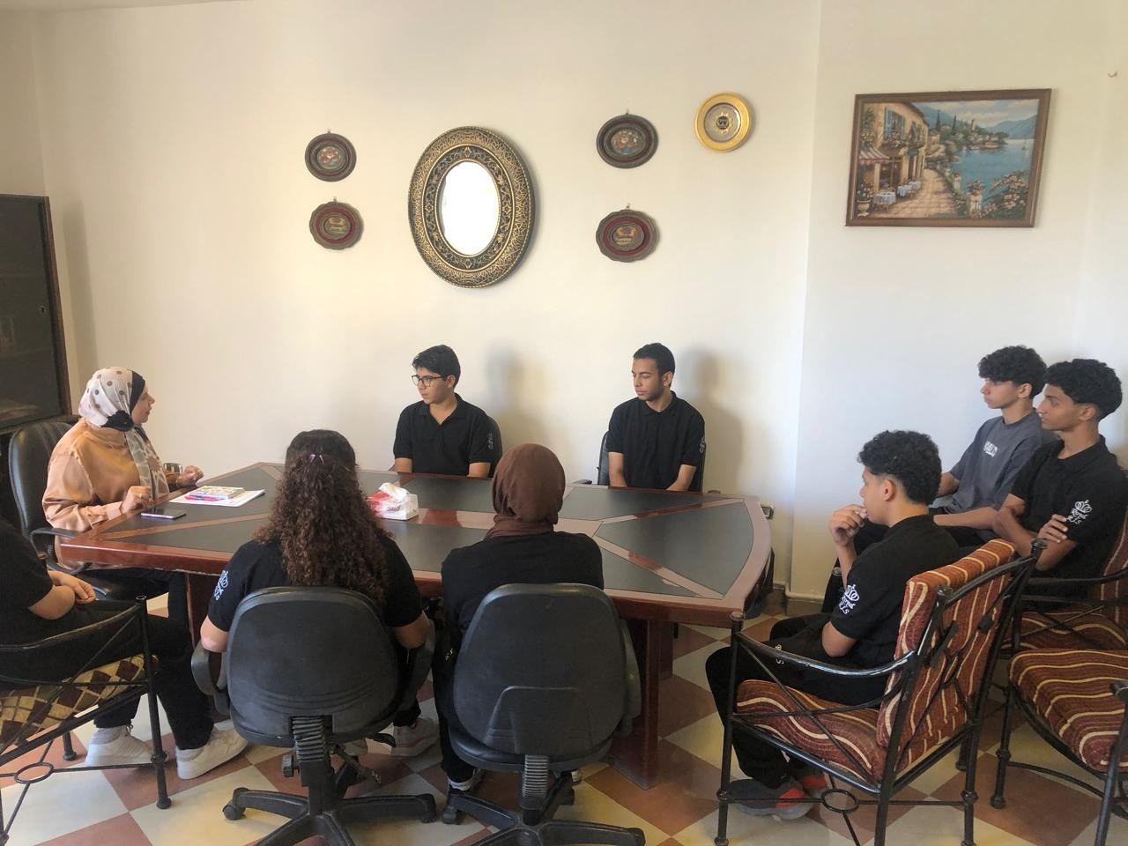
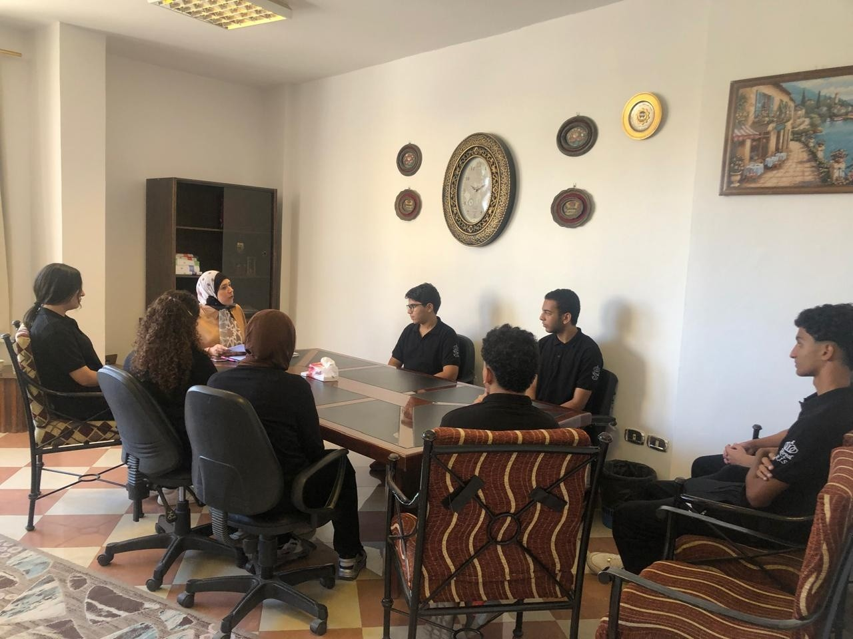

Slide 86
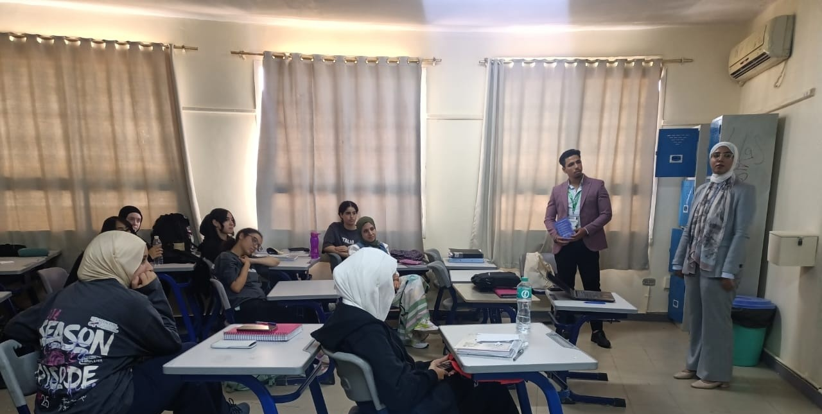
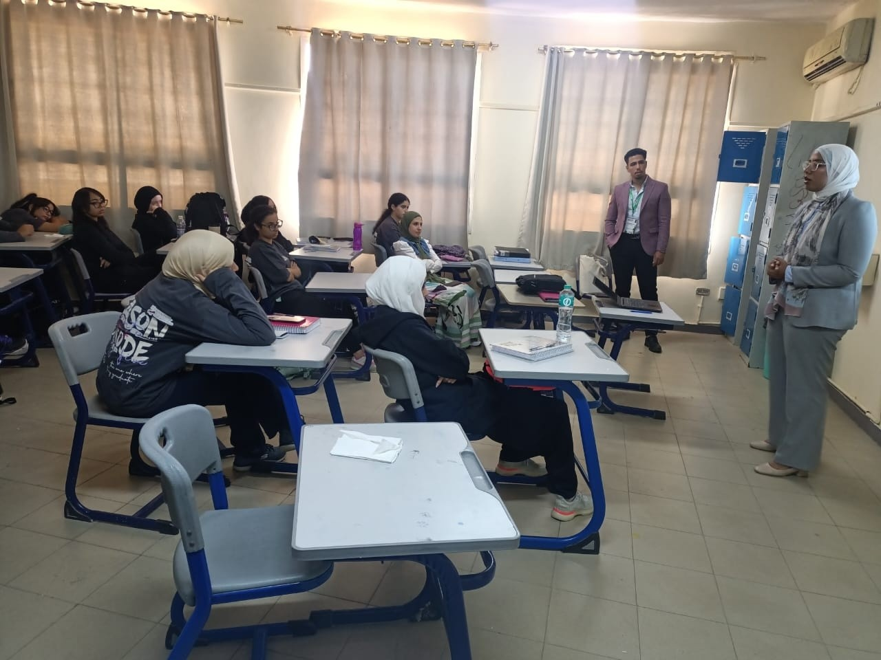
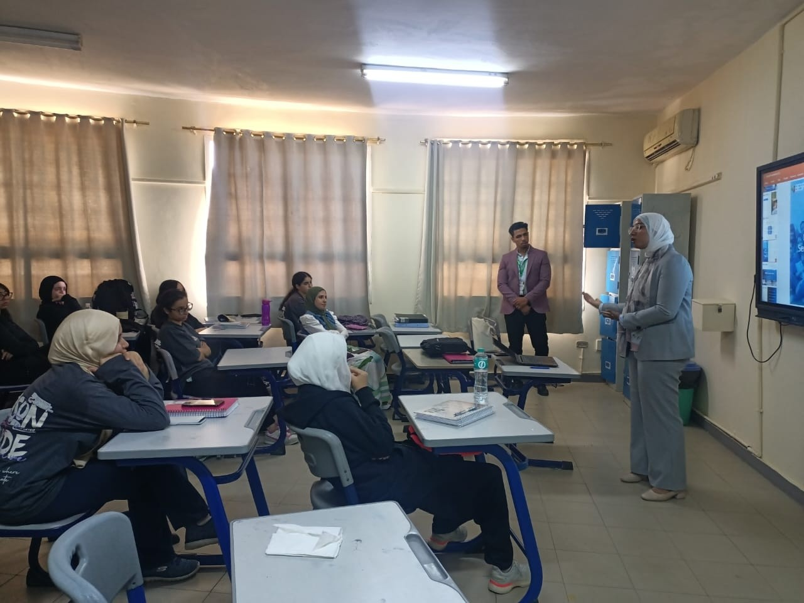
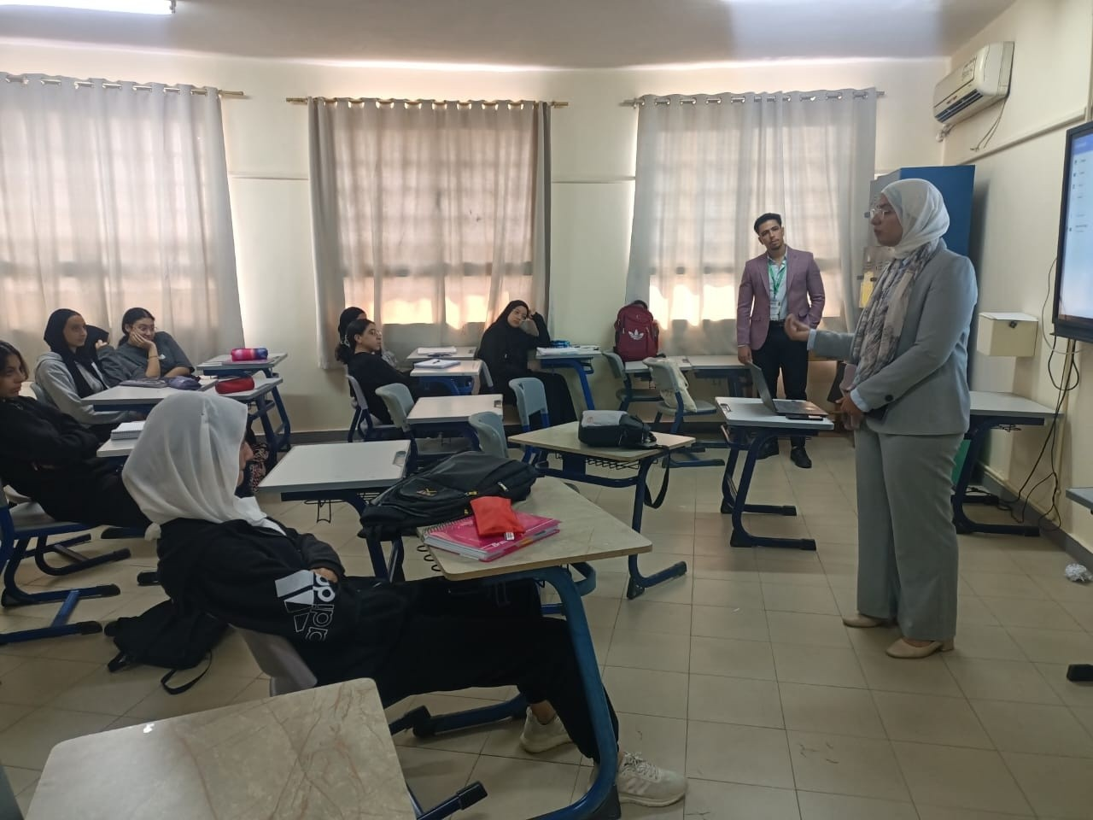

Slide 87
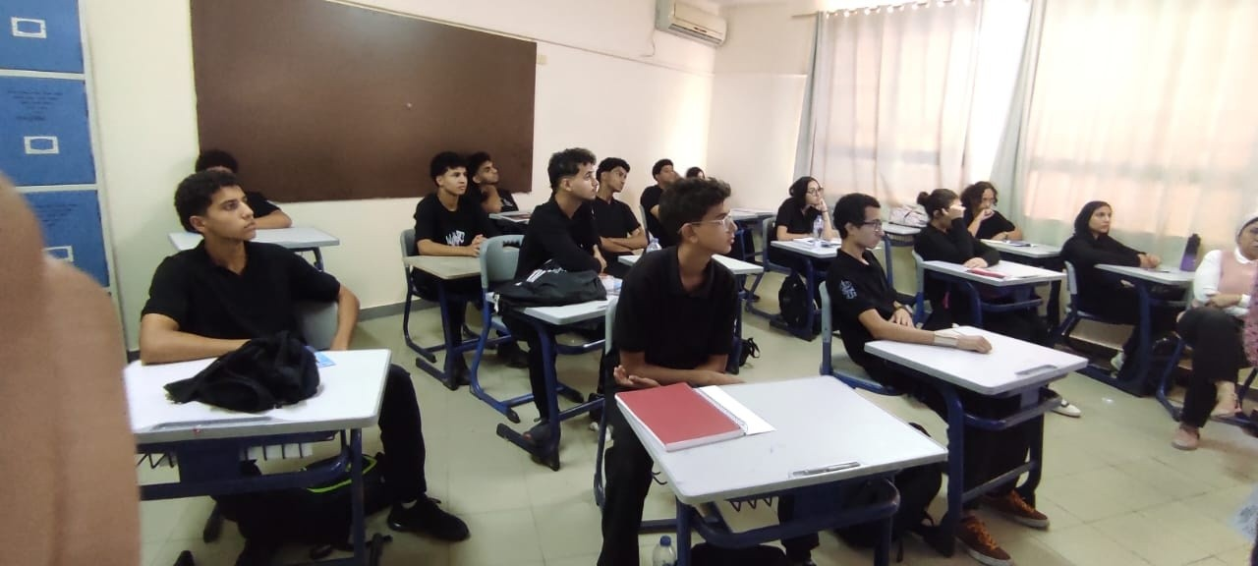
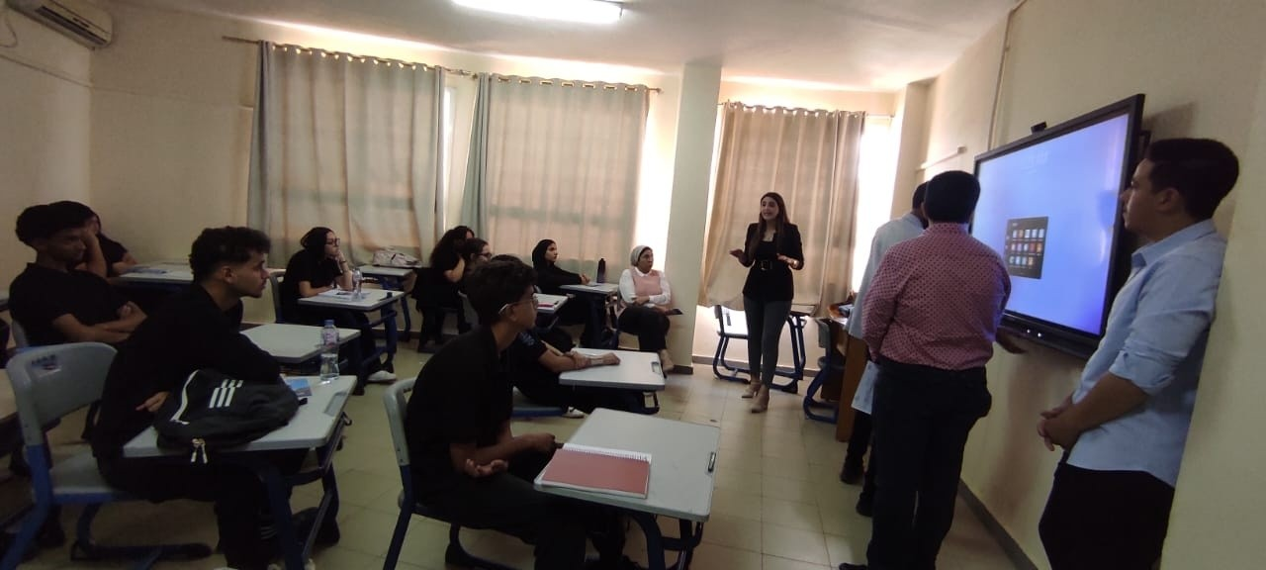
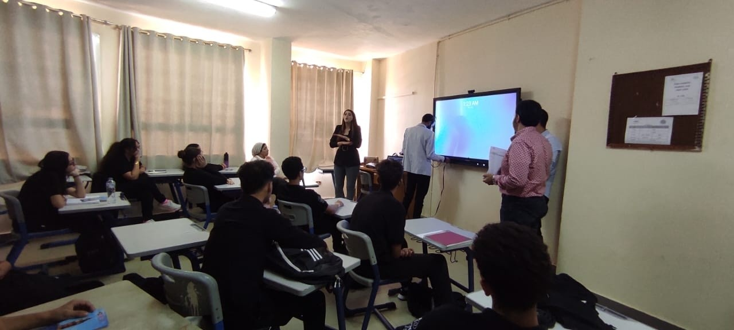

Slide 88
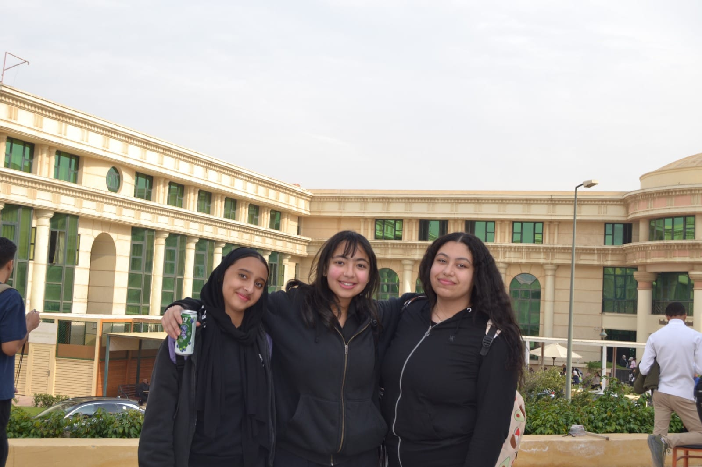
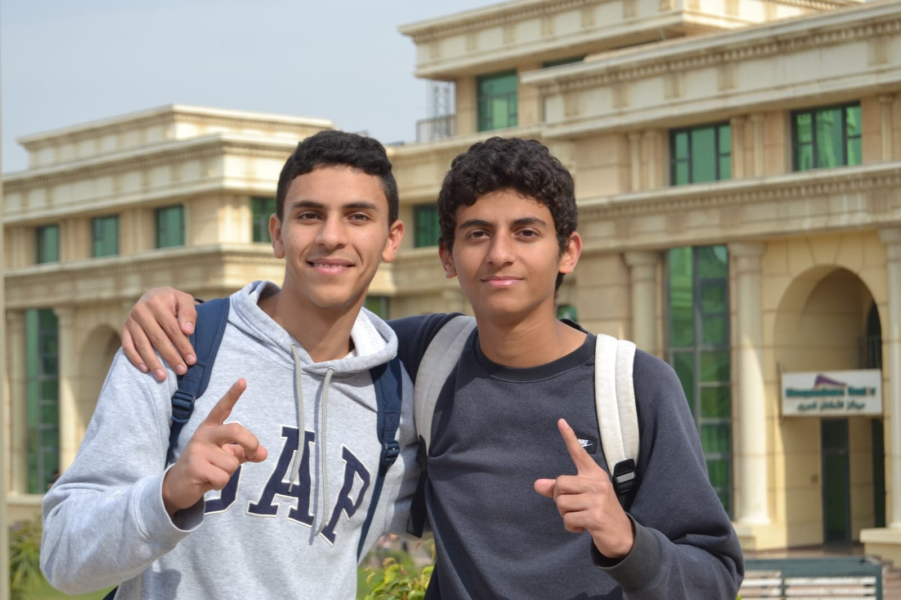
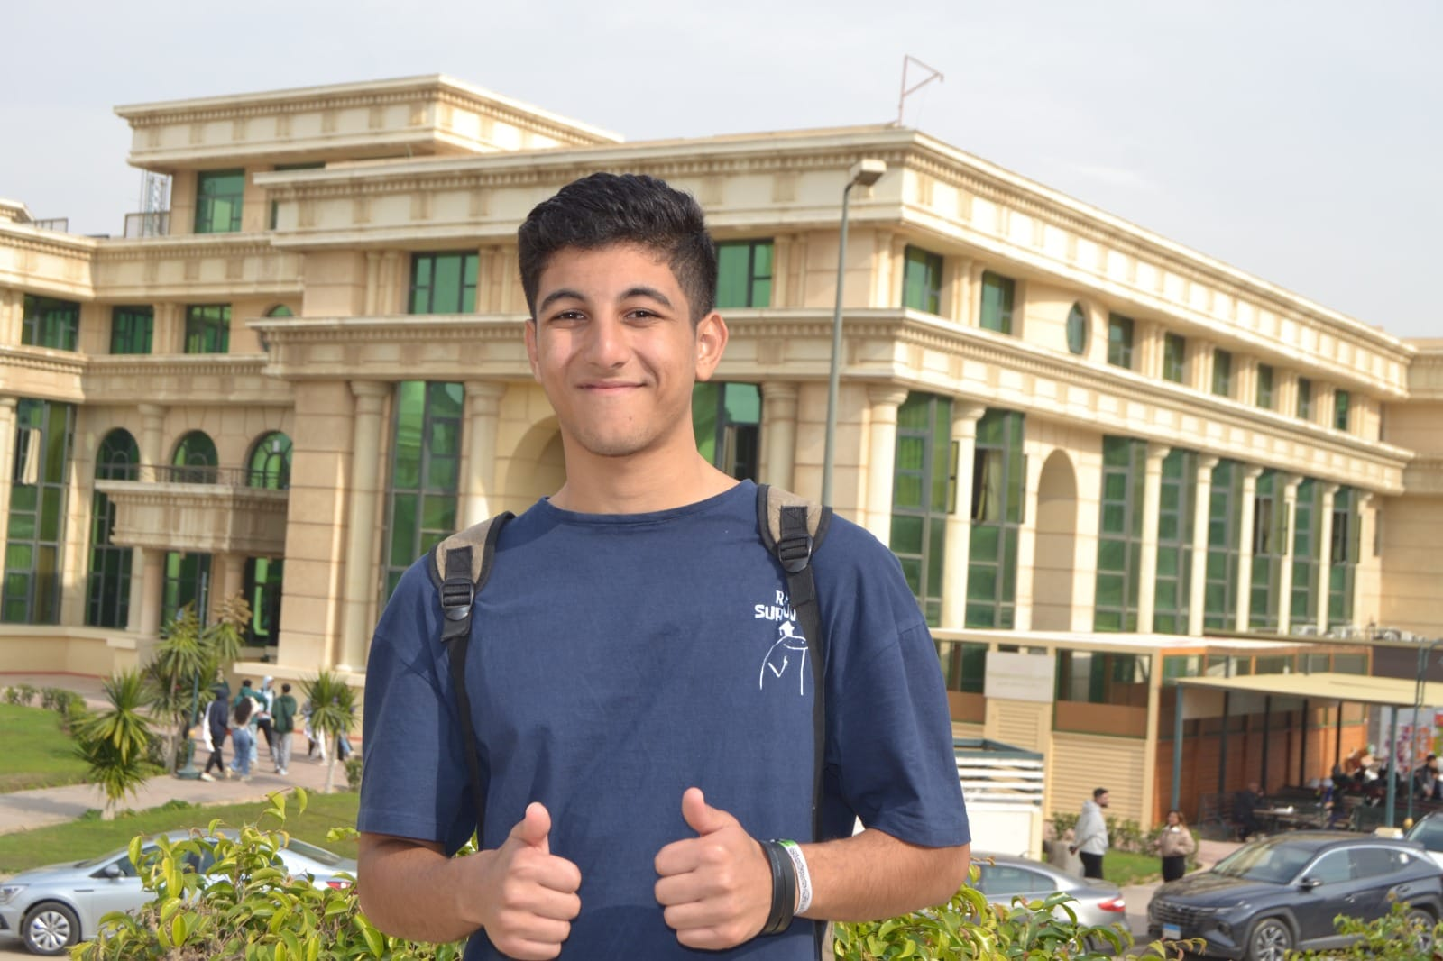
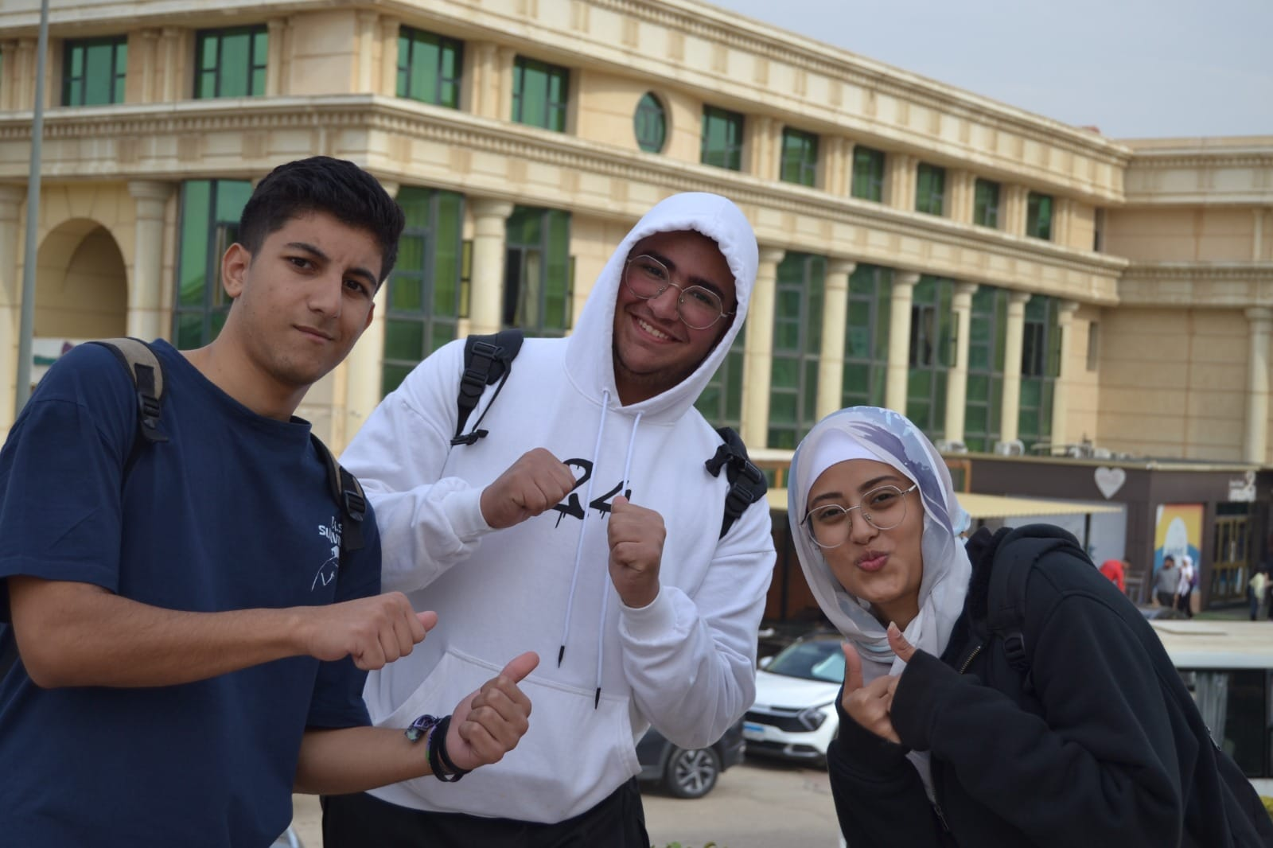

Slide 89
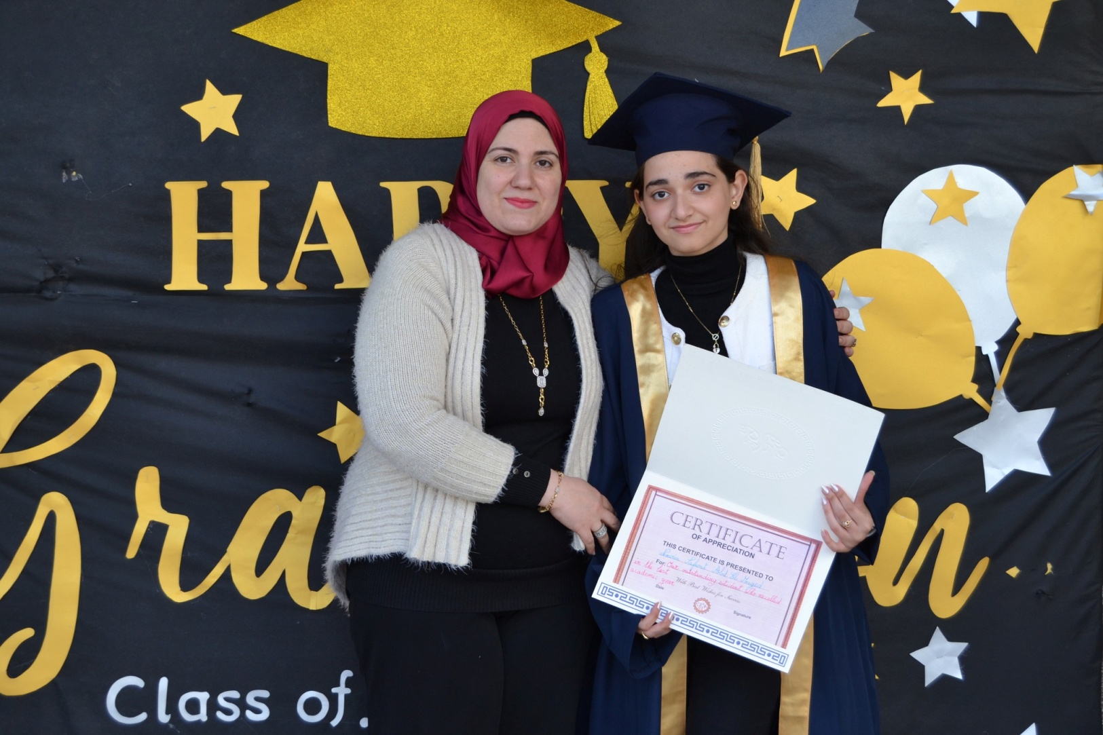
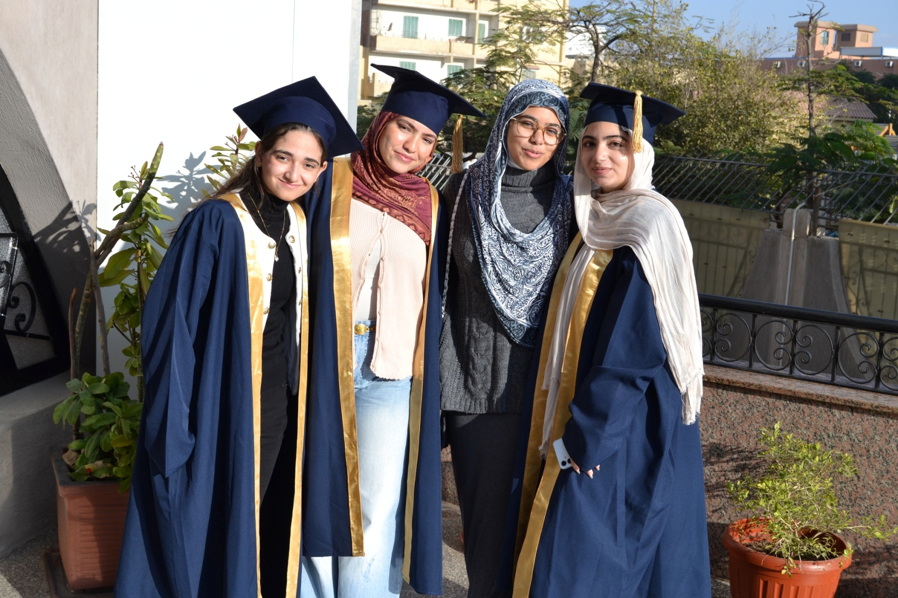
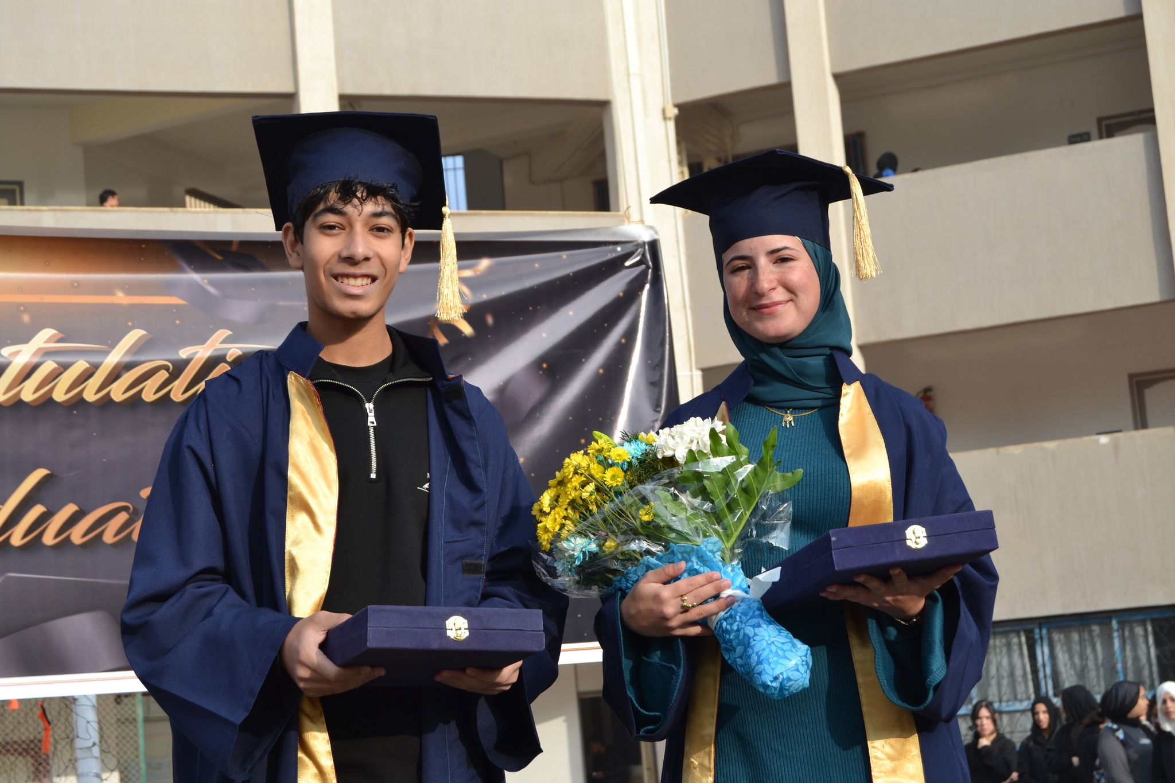
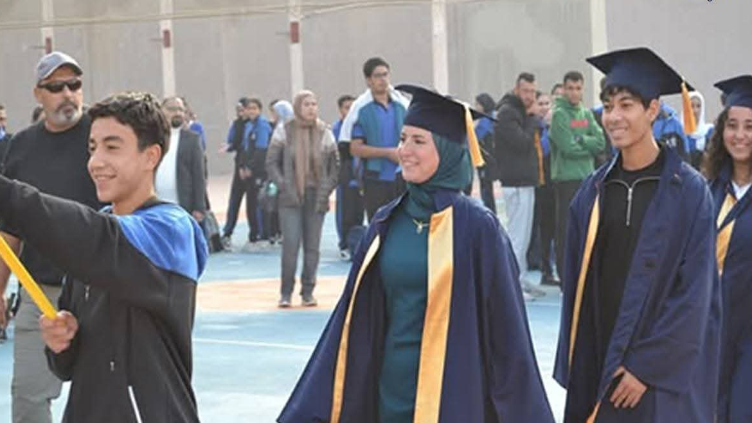

Slide 90
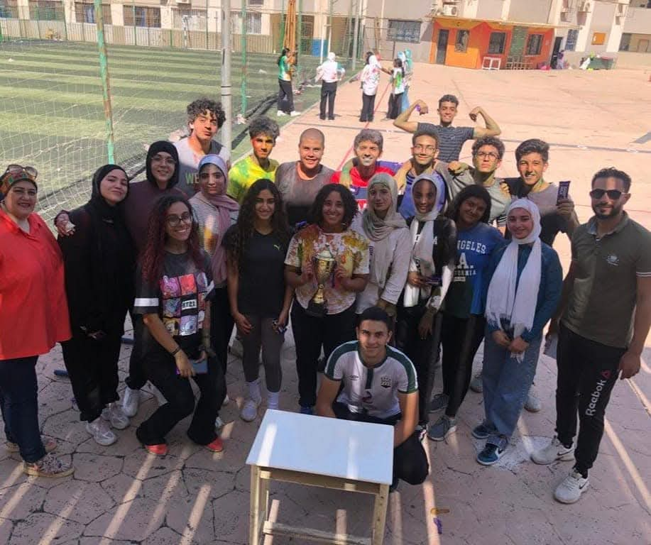
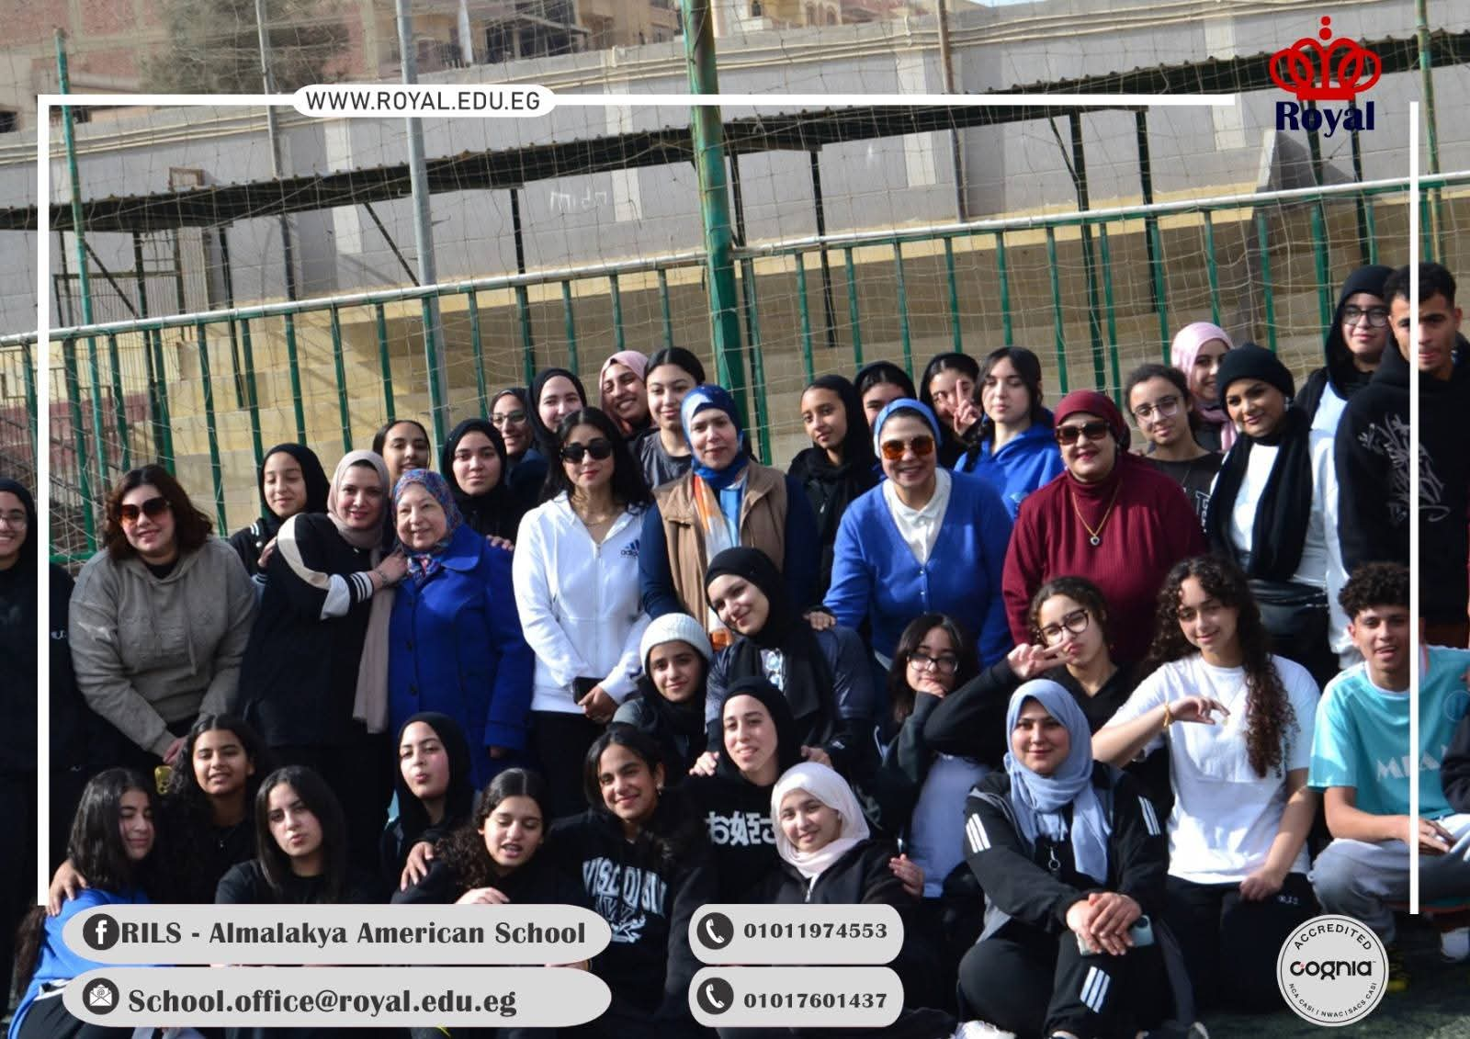

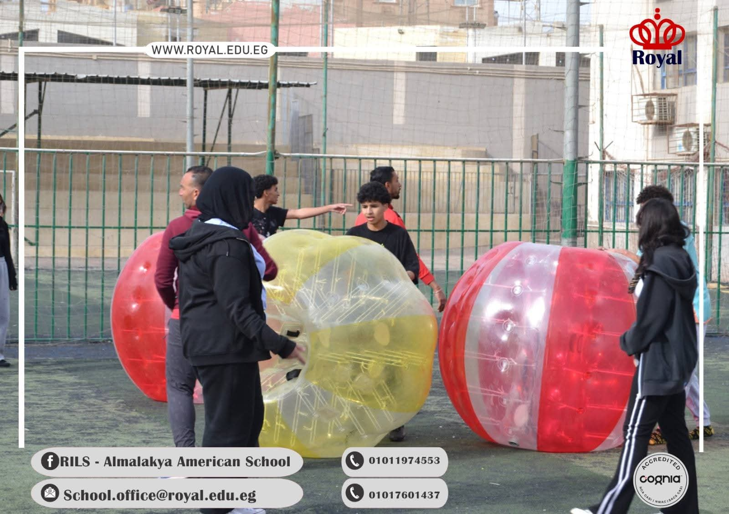
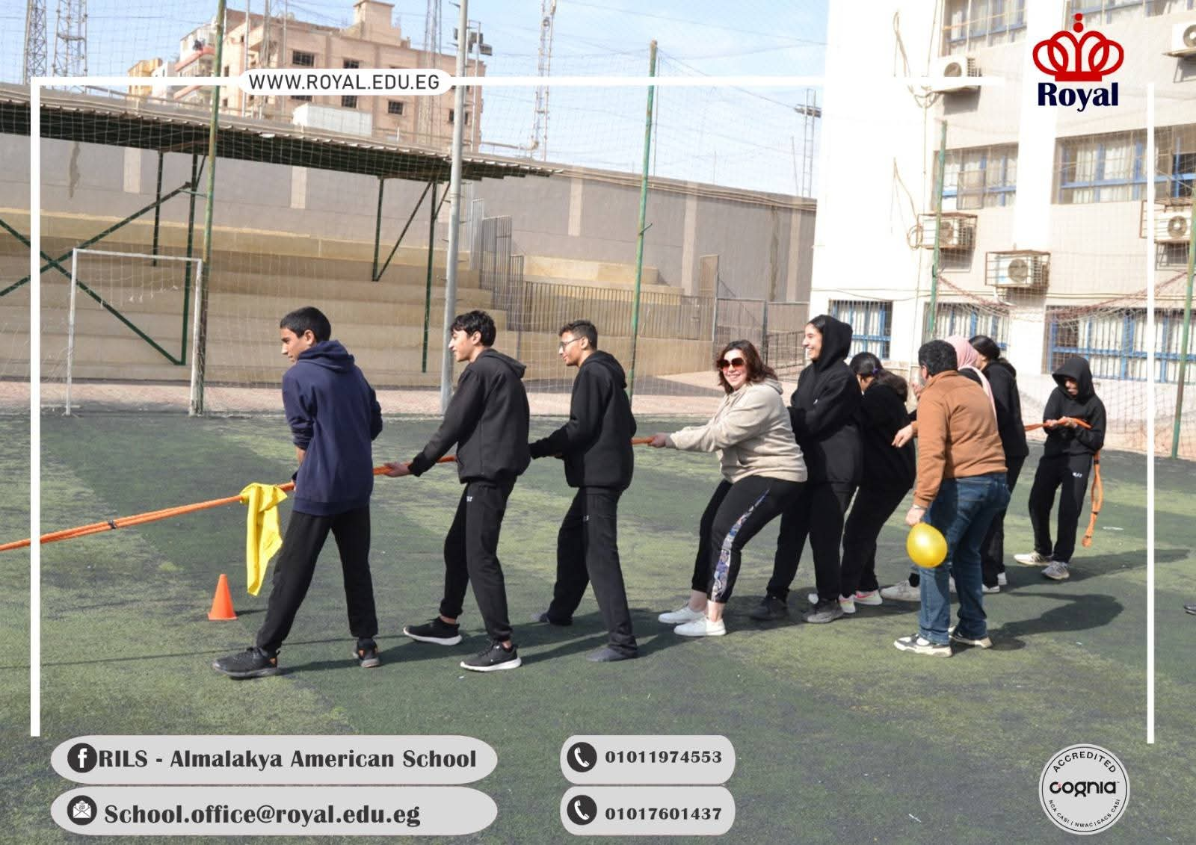
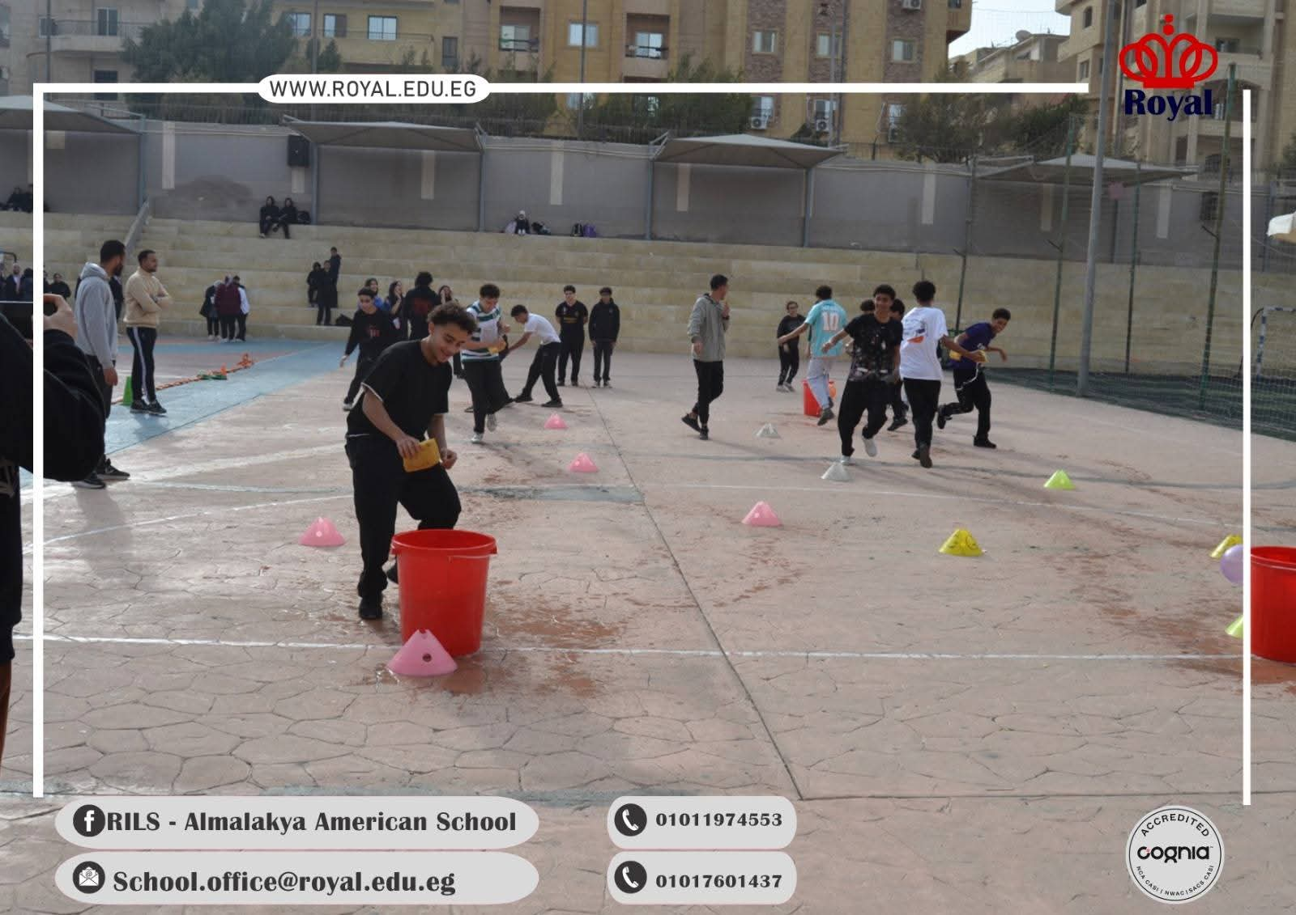

Slide 91
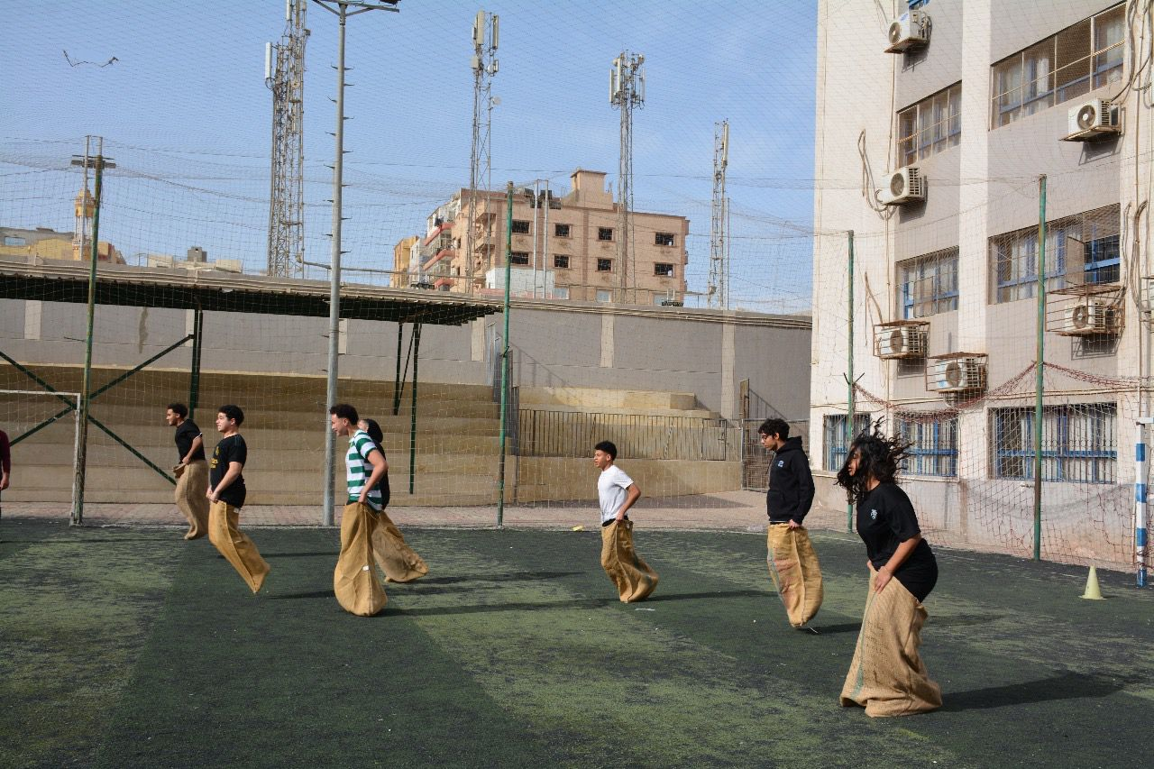

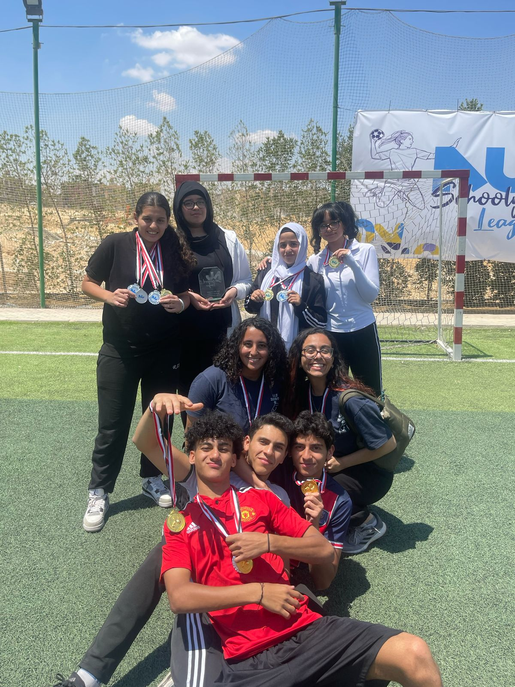
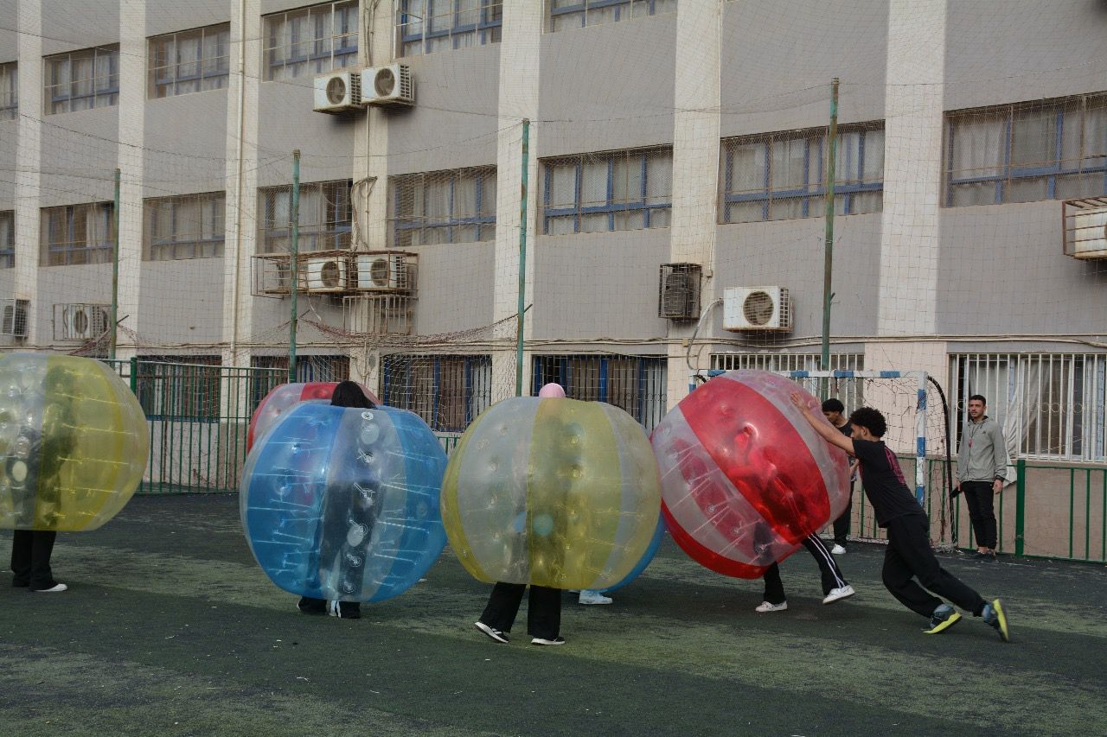

Slide 92




Slide 93





Slide 94



Slide 95






Slide 96






Slide 97







Slide 98





Slide 99






Slide 100








Slide 101







Slide 102





Slide 103






Slide 104



How to contact us?
-Telephone numbers꞉
General School director: 01050695288
Public relations: 01050694468
01017601437 - 01011974553
- Email Address꞉
school.office@royal.edu.eg
mailto:school.office@royal.edu.eg
- School Website꞉
https://royal.edu.eg/about/

Slide 105



Thank You!
DO YOU HAVE ANY QUESTIONS FOR US?

